Slide 1
The 7th Copenhagen Conference on:
Emerging Market Multinationals: Outward Investment from Emerging Economies
The Politics of Internationalization
14-15 October 2021
Copenhagen Business School

Slide 2
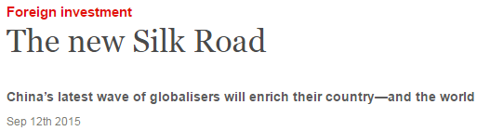

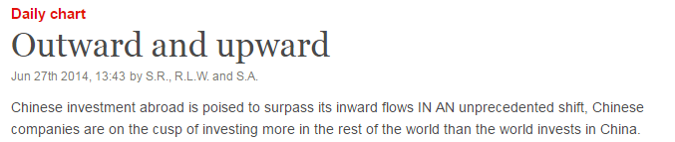
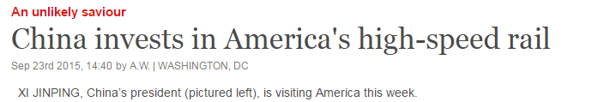
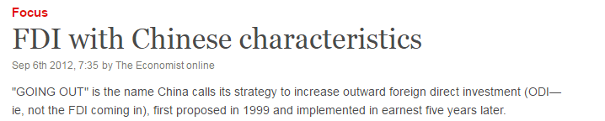


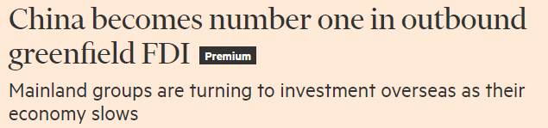
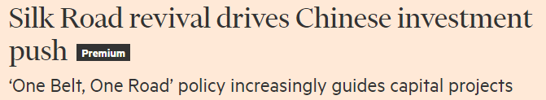
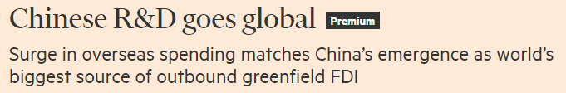


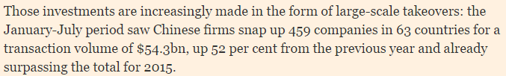
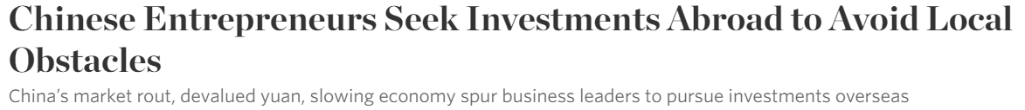
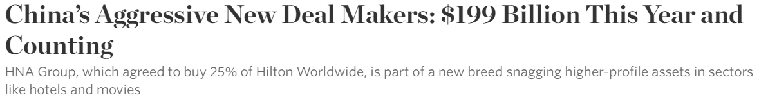

Slide 3
Source: UNCTADstat

Slide 4
Share of selected countries/regions in worldwide stock of outward FDI, various years
REGION/COUNTRY | 1914 | 1969 | 1980 | 1990 | 2000 | 2010 | 2019
Europe* | 93% | 43% | 40% | 47% | 43% | 48% | 41%
UK | 50% | 16% | 14% | 10% | 13% | 8% | 6%
France | 43% | n/a | 4% | 5% | 5% | 6% | 4%
Germany |  | n/a | 8% | 14% | 7% | 7% | 5%
Netherlands |  | n/a | 9% | 5% | 4% | 5% | 7%
USA | 6% | 55% | 39% | 32% | 36% | 24% | 22%
Japan | 0% | 1% | 4% | 9% | 4% | 4% | 5%
Emerging markets** | 0% | 0% | 13% | 6% | 9% | 15% | 23%
China | n/a | n/a | n/a | 0% | 0% | 2% | 6%
World OFDI stock (USD billion) | n/a | n/a | 559 | 2,255 | 7,409 | 20,465 | 34,571
Source: 1914 and 1969, Ramamurti (2012), 'What is really different […]'; other years, UNCTADstat
*'Europe': 'Developed Europe' in UNCTADstat (excludes former East bloc states)
**'Emerging markets': 'Developing countries' in UNCTADstat (where the 'Emerging markets' category includes developed countries)

Slide 5





Companies in the Fortune Global 500
 | 2005 | 2010 | 2015 | 2016 | 2017 | 2020
Brazil | 4 | 7 | 7 | 7 | 7 | 7
Russia | 5 | 7 | 5 | 5 | 4 | 4
India | 6 | 8 | 7 | 7 | 7 | 7
China | 20 | 61 | 98 | 103 | 111 | 124
BRIC | 35 | 83 | 117 | 122 | 129 | 142
U.S. | 170 | 133 | 128 | 134 | 126 | 121
EU+UK | 165 | 148 | 129 | 116 | 110 | 120
Japan | 70 | 68 | 54 | 52 | 53 | 53
Total | 440 | 432 | 428 | 424 | 418 | 436

Slide 6
Does extant IB theory apply to EMNCs?
Three positions:
  Yes (Narula, 2012; Rugman, 2010; Verbeke & Kano, 2015)
  Yes, with modifications (Cuervo-Cazurra & Genc, 2008; Ramamurti, 2009; Hennart, 2012; Gammeltoft, Barnard & Madhold, 2010; Guillen & Garcia-Canal, 2009)
  No (Mathews, 2006; Child & Rodrigues, 2005; Luo & Tung, 2007)
Example deviations
Product life cycle | Incremental internationalization | OLI | Internalization
EMNCs internationalize from South to North Overseas markets may be more attractive than home market Production may not be moved to (other) low-income countries | EMNCs more often internationalize to exploit differences and not just market similarities EMNCs often internationalize faster, with higher commitment modes and (psychic) distance, skip stages, etc. | EMNCs often internationalize with weak or untraditional O advantages EMNCs are more likely to internationalize to acquire O advantages EMNC may internationalize due to disadvantages at home Less likelihood that production is moved when exploiting L advantages | EMNCs have higher tendency to internalize due to higher transaction costs at home EMNCs from different home countries have different propensities to internalize
Based on Cuervo-Cazurra, 2012

Slide 7
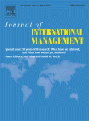


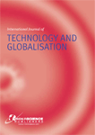



OFDI conference 2008-
Themes
General outward investment
‘Innovation and global knowledge flows’
‘Home country-related aspects’
‘Regional clusters and international linkages’
‘The internationalization process’
‘The politics of internationalization’
Number of paper presentations
2008 | 2010 | 2012 | 2014 | 2016 | 2018 | 2021
36 | 28 | 29 | 28 | 20 | 33 | 14
Special issues
‘Internationalization process’, ‘Innovation & knowledge flows’, ‘Home country effects’, ‘Strategic fit’, ‘National development strategies’, ‘Macro- and micro-level theory’, ‘Home and host country effects’, ‘BRICS’

Slide 8
JIM SI: Enriching Internationalization Process Theory:
Insights from the Study of Emerging Market Multinationals
Peter Gammeltoft
Alvaro Cuervo-Cazurra

Slide 10
Abstract
We argue and explain how the study of emerging market multinational companies can help enrich our understanding of the internationalization process. Firms’ internationalization process is a central and enduring theme in international business. However, most of the theoretical models are built on the analysis of advanced economy multinationals. Emerging market multinationals differ crucially on the role that the home country plays in their behavior, resulting in different patterns of internationalization processes. We propose that the discussion of the applicability of extant theory can be advanced by differentiating internationalization theories according to three different ontological perspectives: resource based, transaction based, and process based. We further suggest that the study of emerging market multinationals’ internationalization processes reveals three contextual accelerators: government, catch-up, and global value chains. These accelerators help adapt internationalization models to new contextual realities.

Slide 11
Content
  Trends in outward direct investment from emerging economies
  Major themes in the literature on emerging market multinationals
  Three perspectives on internationalization: resources, transactions, and processes
  Emerging market multinationals and the three perspectives on internationalization
  Enriching internationalization process theory with insights on emerging market multinationals: government, catch-up, and global value chain accelerators

Slide 12
Trends in outward direct investment from emerging economies
  Emerging economies are assuming increasing importance, economically, technologically, institutionally, politically
  Increasing importance of EMNCs
  China
  Protectionism/nationalism not likely to significantly dent internationalization

Slide 13
Major themes in the literature on emerging market multinationals
  Existence
  Motives
  Process
  Governance
  Impacts

Slide 14
Three perspectives on internationalization: resources, transactions, and processes

Slide 15
Emerging market multinationals and the three perspectives on internationalization
Resource oriented
  Have, have not, have different FSAs
  Frugal innovation, process efficiency, preferential factor access, institutional flexibility, government support
  Locational advantages
  Ambidextrous effect of home country conditions
Transaction oriented
  Corporate and international governance, governance discretion, M&A strategy, technology-market bundling
Process oriented
  More ‘aggressive’ process: home-country learning, competitive pressures, latecomer characteristics, government incentives
  Home-country effects: host country distances; learning-driven investments; home-host arbitrage; strategic intent, network support

Slide 16
Enriching internationalization process theory with insights on emerging market multinationals: government, catch-up, and global value chain accelerators

Slide 17

IBR SI CfP: Emerging Market Multinationals and the Politics of Internationalization
This special issue aims to enhance the understanding of the contemporary role of politics in the global economy and its significance for international business. At a more general level, the special issue aspires to contribute to a better integration of the role of politics and of non-markets strategies into international business theories, dimensions that have so far not been subjected to much systematic treatment.
The focus on outward investment from emerging economies and emerging market multinational enterprises (EMNEs) supports this agenda particularly well. It serves as a laboratory or extreme case to bring out more clearly the different dimensions of the special issue theme and their implications. Issues of politics, policies and institutions are often especially pronounced, both in home and host countries, when we consider EMNEs relative to multinationals from advanced economies (AMNEs). EMNE strategies are becoming entwined with those of governments, political parties, lobbyists, and other formal and informal institutions, in a variety of constellations. In emerging-economy home countries, where market failures and institutional voids tend to be widespread, the state more often than not plays a relatively active role in the economy and EMNE strategies and operating modes are more conditioned by politics, policies and non-market considerations. In advanced-economy host countries, there are often more sensitivities associated with EMNEs than with AMNEs, and political and regulatory responses are more pronounced. In both emerging and developing economy host countries, it is not uncommon for EMNE activities to be underpinned and conditioned by formal or informal interactions between home and host country governments. This special issue aspires to shed more light on the multi-level interrelationships between politics and EMNEs’ internationalization and the non-market agenda for their international strategy.
Submission deadline: 1 December 2021
https://www.sciencedirect.com/journal/international-business-review/about/call-for-papers#emerging-market-multinationals-and-the-politics-of-internationalization

Slide 18
Enjoy the conference!

