Slide 1
1

Slide 2
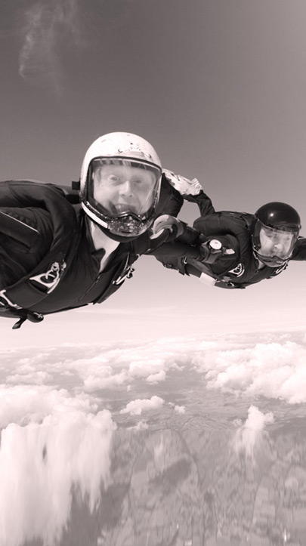
CONTENTS
Mahindra Group & Tech Mahindra
Europe Overview
Copyright © 2013 Tech Mahindra. All rights reserved.
2

Slide 3
Aerospace
Automotive
Components
Defense
THE MAHINDRA GROUP
6 decades of excellence
$16.2 bn
revenue
155,000 Associates
100+
Countries
Farm Equipment
Financial Services
Information Technology
Leisure & Hospitality
Real Estate
Retail
3

Slide 4
TECH MAHINDRA
$2.7 bn revenue
25 years
90,000 Associates
60
Countries
537
Clients
Copyright © 2013 Tech Mahindra. All rights reserved.
4

Slide 5
CONTENTS
Mahindra Group & Tech Mahindra
Europe Overview
Copyright © 2013 Tech Mahindra. All rights reserved.
5

Slide 6
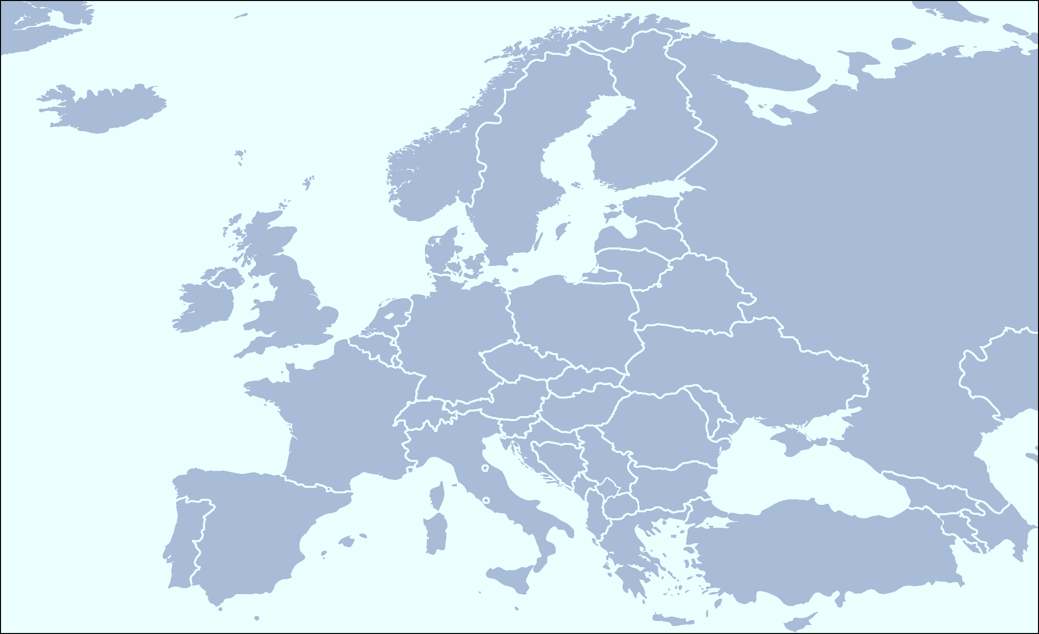
Our presence in Europe
Branch offices (15)
Development Centers (8)
Finland
Norrway
Eindhoven &
The Hague
Sweden
Milton Keynes
Lund
Brussels
Denmark
Belfast
UK
NL
Germany
Czech Republic
Basingstoke
Belgium
France
Switzerland
Toulouse
Italy
Spain
Notes:
Sweden, Dot in copenhagen and Norway office

Slide 7
Europe’s Business Split
Europe: Contributes to 33% of total TechM revenues
Total 2900+ Associates based in Europe & 7000 offshore working for European customers
140+ customers
7 Development Centers
Business footprint spans more than 20 Countries
15 Sales Offices
Augmented by TechM LATAM capability to address some of the multilingual needs
Partnership with niche, specialist vendors

Slide 8
Key highlights
Moving forward with existing relationships
30+ new logos acquired
Five new delivery Centers established: Hague, Toulouse ,Eindhoven ,Lund & Brussels
Acquired Sweden based Sony Mobile Communication's Type Approval Lab
UK
Swiss
We have been in Nordics since 2003
Nordics is one of the Key Focus Regions for Tech Mahindra in Europe; we have growth strategy – organic and inorganic
Nordics Contributes 10% of European Revenue for Tech Mahindra
Around 1500+ Tech Mahindra Associates work for Nordics Customers
Germany
Nordics
Benelux
FROC

Slide 9
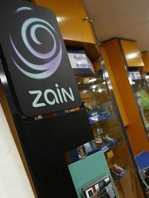
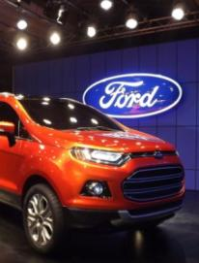
CUSTOMER SPEAK
Well done to all - this is a jewel in the global sourcing crown ! In particular I am pleased to see the ZERO ATTRITION that we have had and long may it continue.
- Ian Symington, Program Director, BT
Mahindra Satyam team is a great example of individuals who do WHATEVER IT TAKES to do the job. - Dick Wiles, Executive Co-Chairman, FIFA
The DOMAIN UNDERSTANDING that Tech Mahindra brought to the project made the whole implementation smooth.
- Mohamed Rafi, Group CIO, Zain Group
We would like to compliment the PROFESSIONALISM, ENTHUSIASM AND CAPABILITY of the Mahindra Satyam team. - World's largest vehicle manufacturer
9

Slide 10
Thank You

