Slide 1
Tata Consultancy Services - CBS 2014
Copyr
1

Slide 2
Tata Group
India’s largest conglomerate
100 operating companies in 7 business sectors
Chemicals
Consumer
Energy
Engineering Information
Services
Steel
Products
Services &
Communication
2

Slide 3
Contribution to the society
Passionate commitment to developing the communities in which we operate
66% of
Endowments for national
Foreign
Contribution to social
Tata Sons
scholarships
equity held
Institutions
for science/
welfare in
in Public Trusts
- higher
engineering
excess of
education, medicine and
$ 100m
annually
sciences
3

Slide 4
TCS ... The 2nd most Valued Brand in Global IT Services
45+
Years in
46
#7 in Revenues
Business
Countries
32% Workforce Women
13.44
Billion US$ in FY14 revenues
1,340
Patents filed till Sep 2013
Leader in Enterprise Mobility Services - Forrester
300,464
19
Innovation Labs worldwide
Employees
India’s Most Valued Company
118
1,500+
Associates
Nationalities
working in R&D
Ranked the #2 most valuable brand in global IT services
Most Valuable Company'
in BT 500 rankings for 2nd year-in-a- row
Insurance Star Performer for 2nd Consecutive Year - Everest Group
4

Slide 5
Making a Difference for Nordic Customers
TCS Nordics Today
▪ 23 years of presence, 6 delivery centers
▪ 7500+ consultants servicing over 75 clients
▪ Over 2000 employees located in Nordics, 500+ local Nordic nationals ▪ Established TCS as a leader in 2nd generation (out)sourcing market across Application & Infrastructure
▪ Engaged with society & academia - CBS, NTNU, Alto, SSIS, Kongsberg Kommune, Helsinki Business Hub etc
TCS Denmark Today
2014 2014
▪ First Nordic Office opened in Copenhagen in 1991 ▪ 25+ active clients
▪ 1.500+ consultants working for Danish customers of which 350+ are onsite in Denmark
▪ Academic cooperation with IT University Copenhagen, Aalborg and CPH Business School
Stockholm Oslo Århus
(1998) (2006) (2011)
Copenhagen Helsinki Reykjavik
(1991) (2000) (2006)
5

Slide 6
TCS Co-Innovation Network

Slide 7
TCS’ Co-Innovation Network
▪ Intel
▪ EMC
▪ SAP
▪ IBM
▪ Cisco
▪ Oracle ▪ Microsoft
▪ HP
▪ India
▪ Corp R&D
▪ US
▪ Industry / Domain/ Geography
▪ UK
▪ Australia
Showcases
Innovation Day
Exclusive workshop to brainstorm on innovation for specific customer need
▪ MetricStream ▪ Collabnet
▪ Qylur
▪ Digite
▪ Right Hemisphere ▪ mCom
▪ Aprimo ▪ Worklight
▪ Cicero ▪ Vistaar
Innovation Forum
Mix of TCS client CXOs, technology experts, , academic partners, TCS R&D and Management
▪ Sequoia Capital ▪ KPCB
Custom COIN™
▪ Gemini
Brings co-innovation to life in context of customer’s business
▪ NVP
▪ Helion Partners ▪ Index Ventures
7

Slide 8
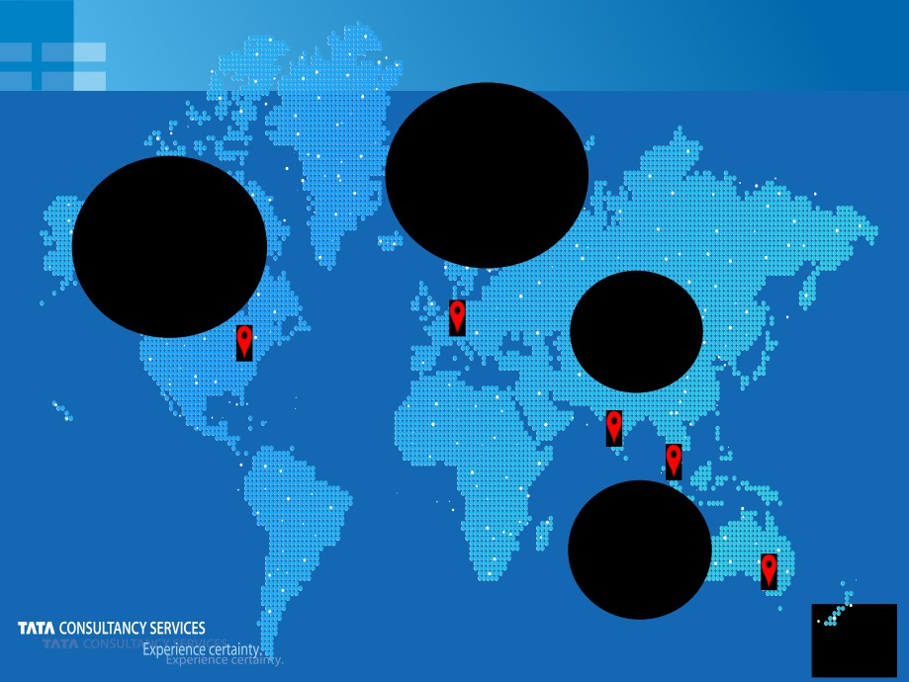
Academic
Aalborg Univ, Said Business School, Oxford Fraunhofer
IESE Imperial
MIT Sloan CISR MIT ILP
College RCA
London Middlesex
U C Berkeley Stanford
University
Purdue
Columbia
IRI
IIT
Bombay ISI Kolkata
SMU,
Singapore Monash Univ
Australia
8

Slide 9
Academic Collaboration in Denmark
The Supply Chain Leaders Forum
Annual event together with CBS HD-SCM where the best thesis is awarded
10,000 DKK by TCS Denmark.
TCS drives the event jointly with the head of the HD-SCM line and fund most of the event via own donation and by helping to get donations from private funds and companies
Joint Research Program
Developing innovative technology solutions for mobile cellular systems. The goal of the cooperation of AAU and TCS is to investigate and propose systems with flexible and adaptive receiver architecture and air interfaces.
attached.
Next Generation Global Software Development
This project aims at providing knowledge and tools for organizations to excel in software development on a global scale.
View cultural diversity as an opportunity for increased innovation Move from an outsourcing model to a collaborative model of GSD
9

Slide 10
Examples: Insurance Innovation
Avatar - Digital Advisor
Retirement Planning App
Rewardz - Loyalty Solutions
iAgent - Mobile Agent
Solution
Gamification Solutions
CUBBUZZ
Text & Voice Analytics
TCS Listening Platform
Integrated Social CRM
Collaboration Platform
Social Influencers
Fraud Analytics Solution
10

Slide 11
Tata Group Commitment
At the Tata Group, we are committed to
improving the quality of life of the
communities we serve. We do this by
striving for leadership and global
competitiveness in the business sectors in which we operate.
Our practice of returning to society that we earn evokes trust among consumers, employees, shareholders and the community. We are committed to protecting this heritage of leadership with trust through the manner in which we conduct our business.
11

Slide 12
Promise what we Deliver;
Deliver what we Promise.
That‘s
CERTAINTY!

