Slide 1
What should we know about EMNCs and the politics of internationalization?
Sarianna Lundan University of Bremen and Aalto University
7th Copenhagen conference on emerging market multinationals:
Outward investment from emerging economies
14 October 2021, Copenhagen Business School

Slide 2
1. Energy transition in emerging economies 2. Energy market in India 3. Policies to facilitate renewable energy investment

Slide 3
IRENA (2020), Global Renewables Outlook: Energy transformation 2050 (Edition: 2020), International Renewable Energy Agency, Abu Dhabi. ISBN 978-92-9260-238-3

Slide 4
Energy transition in EMs: India
Currently 3rd largest CO2 emitter behind United States and China
By 2040 2nd largest CO2 emitter
By 2050 world’s most populous (and mostly urban) nation, possible quadrupling of energy need

Slide 5
Energy market in India
In August 2021 India reached 100 GW installed renewable capacity (wind and solar, excluding large hydro)
4th position in the world in terms of installed RE capacity, 5th in solar and 4th in wind
Modi government goal of 450 GW installed capacity by 2030 (about 60% of installed capacity)
Electricity to meet the growing energy needs, but also to facilitate transition in other sectors such as industry and transportation (e.g. by producing green hydrogen)
Difference between best case and worst scenarios has enormous consequences for India and the global efforts to fight climate change

Slide 6
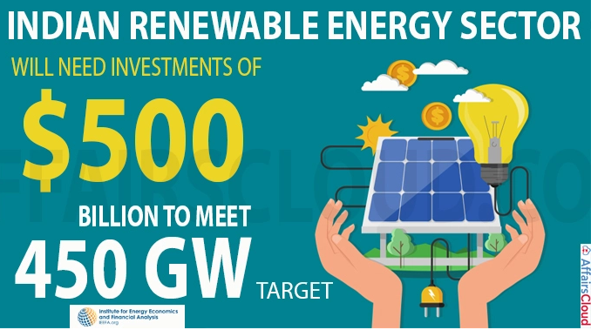
Supportive policies to facilitate investment
Current annual investment is about 10 GW (mostly solar), but 40 GW is needed to reach the goal
Need for regulatory reform: Distribution companies (SOEs) need to guarantee reliable payment to investors
No feed-in tariffs (e.g. Germany 2000-2010) as RE is already cost competitive
Policy entrepreneurship: Centralized auctions with utilities to guarantee a good price for investors
Model for other EMs, opportunities for OFDI by EMNCs

Slide 8
What makes transition risks different from other risks?
They are systemic and involve coordinated collaboration between multiple stakeholders and new combinations of industry partners. They also involve substantial involvement by national governments and supranational entities like the European Union that provide incentives as well as assistance in creating new markets and infrastructure for the transition.
Not only are the risks systemic, but there are multiple systems that run in parallel. Choices that are made by influential actors such as MNEs in one risk system influence not only actors that are members of that system, but other parallel systems as well.

Slide 9
Temporal context and capability development
There is a strong temporal dimension to these risks. On a fundamental level this is driven by the urgency of the need to deal with the climate crisis. On another level it is manifested in competing timelines by public and private actors on reaching carbon neutrality. Another aspect of the temporal dimension is that since dealing with the transition risks involves capital investment with a long life span, investment horizons and the transition horizon are inextricably linked. Finland has declared a goal of carbon-neutrality by 2035.
Due to the systemic and temporal context of the energy transition, there is an urgent need for innovation and the building of new capabilities by MNEs as well as by regulatory bodies to develop product, process and policy innovations in a coordinated manner.

