Slide 1
Huawei Technologies
Enriching life through communication
Tang Wei
Vice President Delivery Management, Huawei Technologies
www.huawei.com

Slide 2
Huawei overview

Slide 3
Huawei was founded in Shenzhen, China’s Special Economic Zone
1987
Huawei, a private company, was founded by Ren Zhengfei and several other investors with an investment of US$3,500. At that time, the company was a reseller of PBX switches of Hong Kong Hong Nian Company.
1992
Huawei developed HJD analog switches that supported 48 ports.
Shenzhen in the early 1980s
1993
Huawei developed C&C08 digital switches, which were primarily deployed in rural areas.
1997
Huawei started engaging global top consulting firms for management transformations.
1999
Huawei established its first international R&D center in Bangalore, India.
2000
Huawei made significant progress in developing countries, e.g., Uzbekistan.
2005
Huawei became a preferred supplier for top carriers such as British Telecom and Vodafone. Revenue from Asia Pacific, the Americas, and EMEA exceeded domestic market for the first time.
Shenzhen after three decades
2009
Huawei deployed the world's first LTE network in Northern Europe.
2010
Huawei transformed itself from a CT company to an ICT company and established three BGs: Carrier BG, Enterprise BG, and Consumer BG.

Slide 4
Today, Huawei is a leading ICT company
Who is Huawei
Employees
A leading global ICT solutions provider
A Fortune Global 500 company, ranking 315 in 2013
150,000+ employees worldwide
70,000+ engaged in R&D
Market Progress
Business Areas
US$39.5B revenue in 2013
Serving 45 of the world's top 50 carriers, which account for 77% of Huawei's revenue generated from the carrier network business
Serving 1/3 of the world's population
Carrier
Enterprise
Consumer

Slide 5
Globalized resource deployment and localized business operations
Netherlands
Toronto
Germany
Hungary
Ottawa
Romania
Silicon Valley
China
Bahrain
Mexico
India
UAE
Malaysia
Huawei Headquarters
Accounting shared service center
Brazil
Bidding center
Supply center & Hub
Mauritius
R&D center
Training center
Argentina
Technical support center
Operations in 170+ countries; 150,000+ employees comprised of 150+ nationalities worldwide ; 30,000+ non-Chinese employees with 70%+ localization rate.
Huawei's global value chain allows fluid capability transfer across the globe, develops and retains talent in local countries, and creates jobs and economic opportunities.

Slide 6
Huawei’s commitment in Denmark and Europe

Slide 7
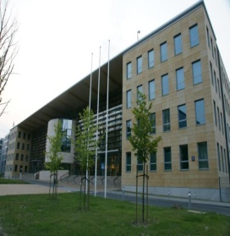
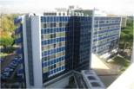
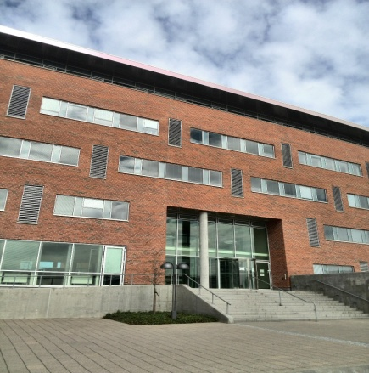
Huawei Europe: Continued Local Commitment
5.23 billion revenue for Europe Region
3.4 Billion US$ Procurement amount
7,700 Employees, 850+ in R&D
2 Regional headquarters: Warsaw & Dusseldorf
2 R&D center and 11 R&D Sites
2 Regional Technical Assistance Centers (24x7)
10 Training Centers
5 Local Network Operation Centers
2 Logistic Centers
Multiple Joint Innovation Centers
Huawei
Sweden
Huawei
Poland
Huawei
Italy
Huawei
Denmark
Huawei
Germany
Huawei
France
Huawei
UK
……
As of 31th December, 2013

Slide 8
Huawei in Denmark
250 employees
Established in 2007
4 offices including
1Network Operation Center
100 new
jobs created
2.7 Billion DKK
Investment over the next 6 year
2.2 Billion DKK
procurement over the next 6 years

Slide 9
Our wider role in the community
Promoting environmental sustainability
Joint innovation with Danish Companies and Universities
Bridging the digital divide
CSR Activities
Building superfast 4G mobile network together with TDC by 2015.
Supporting the government to improve rural area mobile broadband coverage.
Green ICT solutions with lower power consumption and footprint
Dynamic power solution s including solar panel, wind power
2011, award 10 university students Huawei scholarship
2012 signed strategic cooperation agreement with Copenhagen Business School
2014 initiated “Telecom seeds for the future” program, support 10 university talents each year over the next 5 years, to visit China.
Joint innovation with Telecom Operators in Denmark.
Exploring global cooperation opportunities of joint Innovation with Danish companies and Universities.

Slide 10
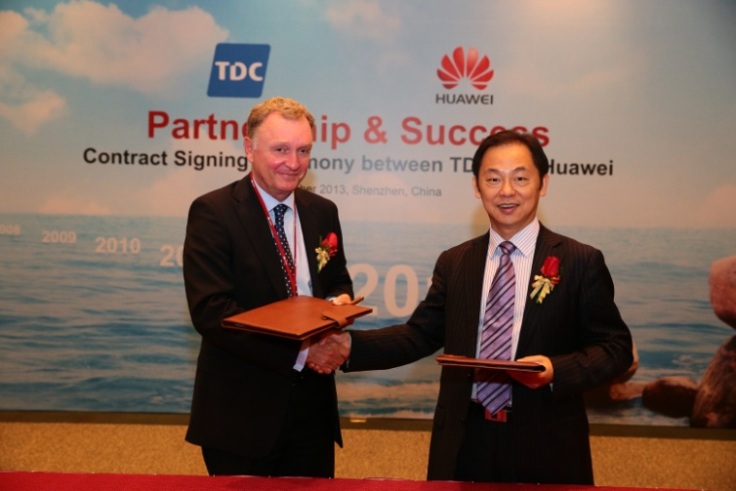
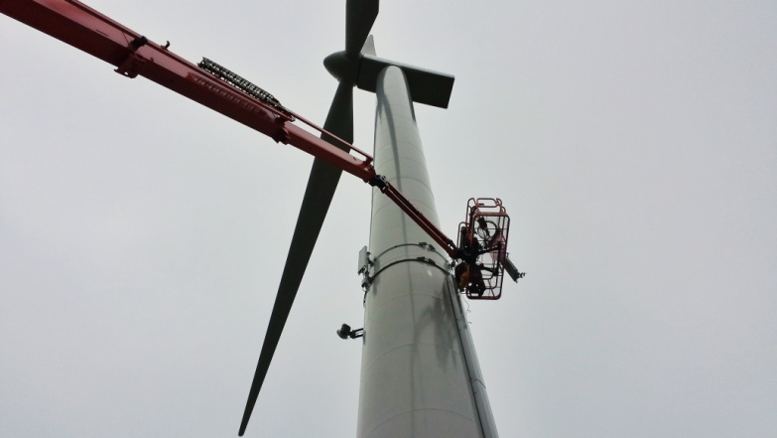
Building one of the world´s most modern mobile networks
Together with TDC, Huawei is deploying a nationwide 4G network that will provide over 99 % of the Danes with high-speed internet access in 2015.
Each user can enjoy in average 10 Mbps mobile internet from 4G network.
The network has an unique focus on quality management and customer experience. Together with TDC, Huawei has set the goal to build Denmark's best mobile network.

Slide 11
Global cooperation with Danish companies
Huawei advocates global supply chain strategy. Danish enterprises is important part of Huawei global supply chain.
The purchasing from Danish enterprises reaches more than 120 M USD since 2009. YOY growth reaches 34.7%, much higher than Huawei procurement yearly growth 13.8%
Unit : K USD | 2009 | 2010 | 2011 | 2012 | 2009～ 2012 | Percentage of Huawei global procurement
Purchasing from Danish enterprises | 18,085 | 26,542 | 39,793 | 42,805 | 127,224 | 0.20%
The estimated purchasing from Danish enterprises will reach 164 M USD from 2013-2015

Slide 12
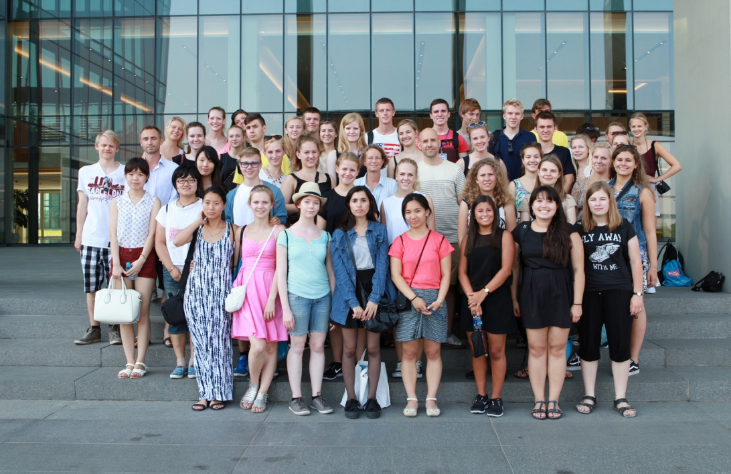
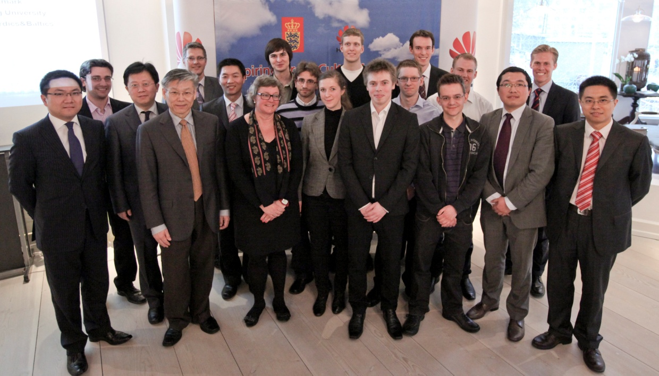
Telecom seeds for the future Program
Education and work experience program for university students with major in technology/science
3 week program that consist of training, lab work and cultural experiences
Opportunity for students to engage in international business culture, hands on training and technical training
5 year cooperation with Aalborg University and Technical University of Denmark initiated in 2014

Slide 13
A better connected world

Slide 14
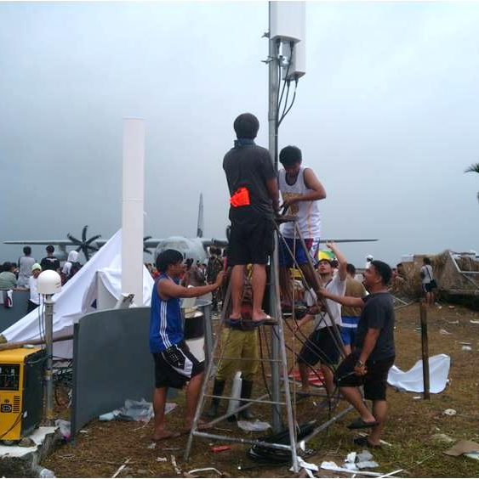
Dedicated to bridging the digital divide
Huawei's goal in bridging the digital divide: connectivity and broadband inclusion for all
Accessibility: Work with carriers to solve the wide coverage problem
Enabling 1.5 billion more people (7.5 billion in total) with access to communications services
Allowing another 300 million households (930 million in total) to enjoy broadband access.
Affordability: Reduce costs with innovative technologies.
Fixed Broadband: down from US$5 to US$3 for each Mbps(Megabit per second)
Next Generation Network: down from US$12 to US$8 for each line
Tablet and smartphone: down from US$300 to US$50

Slide 15
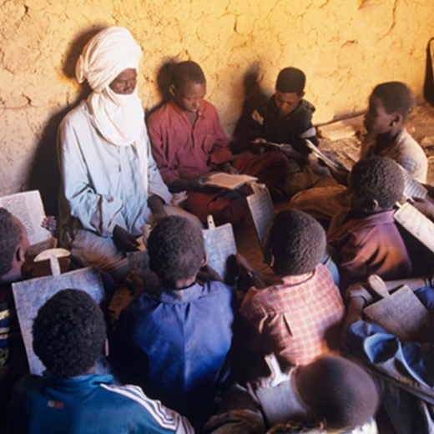
Connecting people with people closer — to spread knowledge and advance education
Traditional classroom teaching
Today:
Only less than 6% of the people in Sub-Sahara areas receive higher education(This figure is 26.5% in China).
Online courses
Including open educational resources
In the future:
Every corner of the world will be connected.
Everyone will be able to afford mobile devices.
Various online education tools will become a part of life.
Students can freely choose the time and venue for learning, which greatly expands learning channels and reduces the cost of education by more than 50%.
Last year, Huawei partnered with Microsoft in the 4Africa initiative in providing smartphones to help more African people get connected.

Slide 16
Focus on ICT infrastructure and be a pipe connecting the world

Slide 17
Focusing on the pipe strategy to lead in the digital era
Information storage and processing
Cloud data center
Enterprise business: steady growth
Become a major ICT infrastructure provider that supports digital restructuring for enterprise customers
Digital society
Big data and big traffic
Information transmission
Network infrastructure
Carrier business: Maintain leadership
Become the best strategic partner for carriers and the industry leader
Information presentation
Network devices
Consumer business: build brand
Become a world-leading smart device brand trusted by consumers

Slide 18
Maintain the leadership position in core technologies
Mobile Broadband
Fixed Broadband
Enterprise business
LTE:
Deployed 110 commercial networks in more than 100 capital cities and 9 financial centers
466 key LTE patents
No.1 position globally
5G:
Set up 5G innovation and research centers in 9 countries
Take the lead in researching air interface links for 5G networks in Europe's METIS project
Plan to invest US$600 million over the next 5 years
Anticipate commercial deployment of 5G networks in 2020.
Launched the 400G core router 1 year ahead of industry peers
The only one of its kind deployed on a large scale
Deployed by 53 customers as of Dec. 2013
World-leading performance and reliability: consumes 1/8 of the power, occupies 1/6 of the area, and weighs 1/12 compared with products with the same capacity in the industry
The first in the industry to launch the 1T router line card.
Launched the world's first service- and user-experience-centered agile network architecture and the world's first agile switch.
Smartphones
Shipped 52 million units in 2013, up 62% YOY
Ranked No. 3 after Samsung and Apple
Notes:
Our smartphone shipments in 2013 reached 52 million units, an increase of 62% year-on-year.
Smartphone shipment target for 2014: 80 million units
In 2013, Huawei ranked third in the smartphone market (with a share of 4.9%), behind Samsung (31.3%) and Apple (15.3%) (Source: IDC).
January 2013: Ascend D2; February 2013: Ascend P2; April 2013: Ascend W2 and Ascend Mate; June 2013: Ascend P6
New products launched at the Consumer Electronics Show (CES): Tron game console (to be sold in China in Q2 2014) and Ascend Mate 2

Slide 19
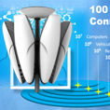
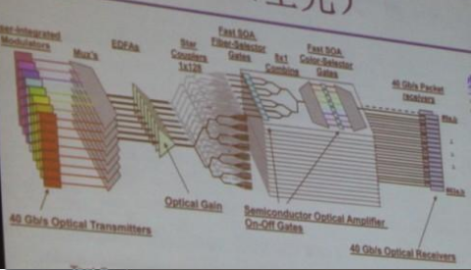
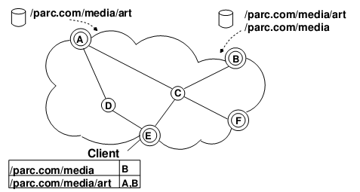
Continuously make future-oriented investment to build future-oriented technological advantages
5G mobile communications
High-throughput computing
Information generation
Information transmission
Information processing and storage
Mirrorsys
All-optical network
Content-aware network
MirrorSys：Offer next-generation fully immersive user experience
5G mobile communications: Conduct research on 5G to continuously enhance wireless network capacity and application scenarios
All-optical network: Break the bottlenecks of transport networks and build limitless transport capacity
Content-aware network: Build the next-generation content-aware and content-based-routing switching network
High-throughput computing: Build a high-throughput computing platform for big data processing and analysis

Slide 20
Long-term investment in innovation
Continue to invest over 10% of revenue into R&D, which enhances our competitiveness while propelling the industry and advancing technologies.
Total R&D investment in the past decade amounted to US$24.9 billion (CNY151 billion).
No. 1 Chinese company with the largest number of patents in China; one of the Top 50 patent holders in the US; one of the Top 15 patent holders in Europe.
$5.1B
$4.9B
$3.9B
$2.9B
$2.3B
$1.8B
$1.4B
$1.1B
$0.6B
$0.7B
Distributed basestation
SingleFAN
All-IP network
SingleRAN
Cloud computing
Optical Transport Network
Single
strategy
400G DWDM
Softcom
5G,
agile switch
2004
2005
2006
2007
2008
2009
2010
2011
2012
2013
Billion US$
Notes:
Key messages:
ICT is a high-tech industry. The major driving force behind its development is customer needs and technology.
Over the past decade, we have been investing more than 10% of our sales revenue in R&D. No matter how the economic environment changes, we believe that only by continuously investing in technology will we be able to provide the highest returns to our customers.
We are well aware that investment in R&D should be approached like a marathon, not a surge like short-distance sprint. We must maintain our efforts, commit time and money, and continue with our research and making breakthroughs into our focused directions.
By doing so, we also drive industry development and social progress. For example, Huawei's SingleRAN ushered in a new broadband era and enables people to enjoy broader bandwidth by paying the same tariff. Another example is our SoftCOM technology that helped carriers construct network architectures based on data centers and turned digital floods into "digital oilfields".
In terms of the number of patents granted in the US, we rank No. 1(the whole Huawei group, including patents granted in US applied by Huawei technology and Huawei US) among enterprises from mainland China and second among Chinese enterprises, slightly behind Foxconn.
TOP 15(ranking 13 in granted patent, ranking 11 in application) in Europe:http://www.epo.org/about-us/annual-reports-statistics/statistics/patentees.html
Huawei has filed a total of 44,168 patent applications in China, 14,555 PCT patent applications, and 18,791 patent applications outside of China. A total of 36,511 patent applications have been granted.
Key messages:
With an insight into the industry's development trends, Huawei has made significant explorations and innovations in the past decade, driving the industry's transformation and development.
In 2004, to address carriers' difficulties in acquiring sites and equipment rooms needed for base station deployments, Huawei came up with the industry's first distributed base station, which has become a solution widely accepted and followed in the industry.
In 2005, Huawei built the SingleFAN platform, the industry's first common platform integrating DSL, fiber, and cable. Today, it has been commonly adopted in the industry.
In 2006, Huawei was the first to raise the idea of All-IP and FMC network architecture, precisely anticipating and steering industry trends. It became Huawei's technology strategy. Nowadays, Huawei has gained a leading position in end-to-end IP technologies and products.
In 2007, after foreseeing that GSM, UMTS, and LTE would coexist for the long term, Huawei put forward the SingleRAN strategy, which now has become a basic industry criterion.
In 2008, with an insight into the transformation trends of cloud computing technology and business model, Huawei made the decision to enter the cloud computing field, becoming the first entrant among telecom players. Today Huawei has made significant progress in this field, with large-scale commercial applications with SingTel, China Mobile, and many other carriers. In addition, Huawei has set up over 50,000 virtual desktops inside the company, the largest such application in the world.
In 2009, Huawei led the establishment of OTN standards, shaping the future of optical network development.
In 2010, based on SingleRAN, Huawei established the Single Strategy, which integrates multiple networks into one network.
In 2011, Huawei launched the industry's first 400G DWDM optical transport system. This system supports a capacity of up to 20 Tbit/s over a single fiber (C-band) and a transmission distance spanning 1000 km without electrical regeneration, boasting the largest transmission capacity among WDM systems at the time.
In 2012, to accommodate needs of fast service deployment and open network platforms, Huawei raised the idea of SoftCOM, which builds network programmability and achieves the goal of a software defined network.
2013，SoftCOM, Huawei’s strategy for network architecture for the coming decade, is a revolutionary vision that leverages cloud computing, software-defined networking (SDN), network functions virtualization (NFV), and internet-based operations to streamline the networks of telecommunications operators and maximize information technology (IT) resources. The services, efficiencies and overall operations of the telecom industry will be dramatically improved due to the reconstructing of the architecture of networks to become defined by software and not hardware. SoftCOM will help telcos to embrace the strategic opportunities of the information age and effectively manage the challenges brought about by the structural limitations of existing networks.

Slide 21
Thank you!

