Slide 1
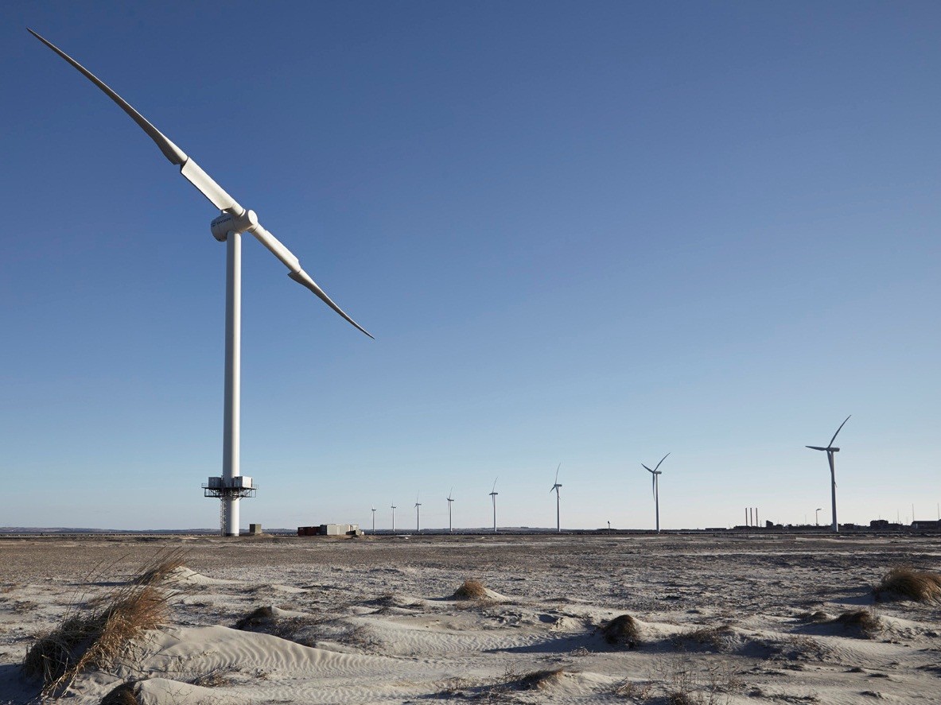

CBS Conference upon
“Emerging Multinationals”
Anders Rebsdorf
2014.10.10

Slide 2
Content
Envision Energy – Introduction
Global Innovation Centre, What, Why Denmark
Partner selection process – Europe / Globally
Milestones , Domistic China, ROW
How is capacity built up?
M&A – Collaborative activities
Overseas markets – Envision position and strategy

Slide 3
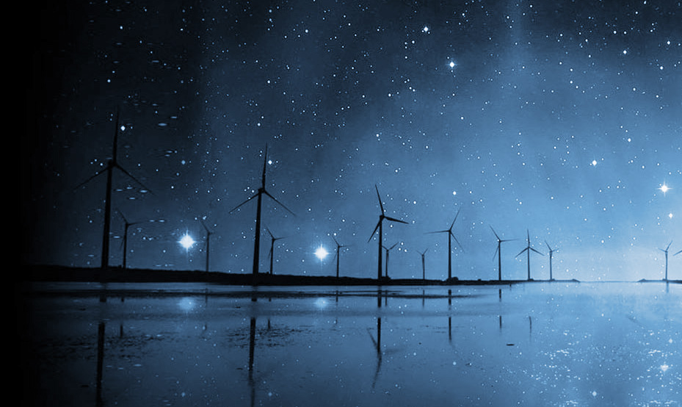
Envision’s technology solutions in renewable area
SMART turbines
Low wind turbines
Offshore turbines
Smart Wind Farm System

Slide 4
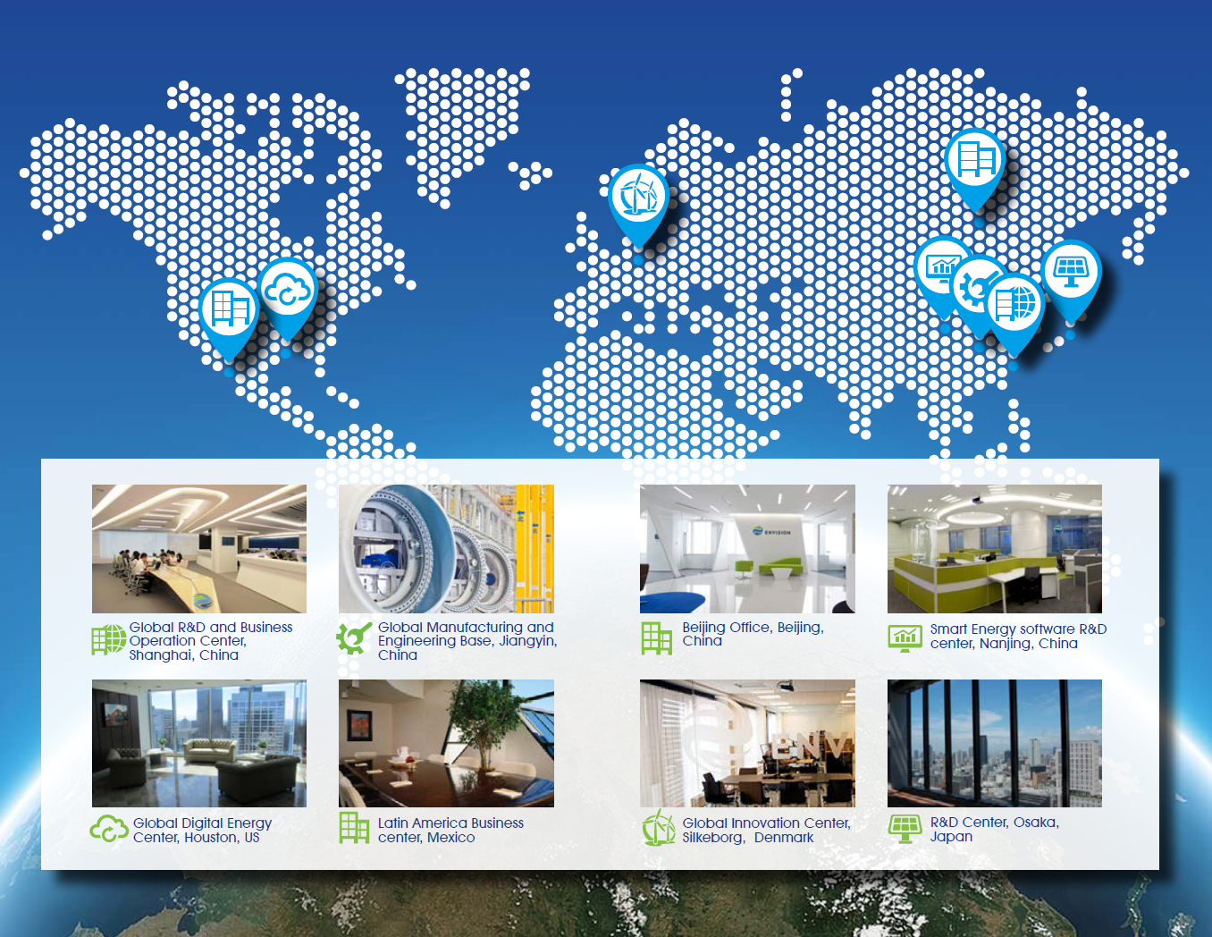
Rooted in China. Global footprint.
Working with market leaders and world-class partners

Slide 5
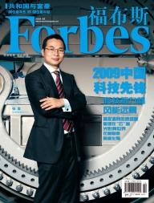
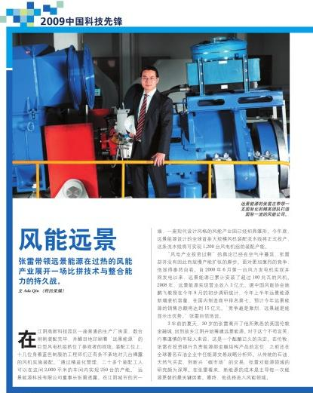
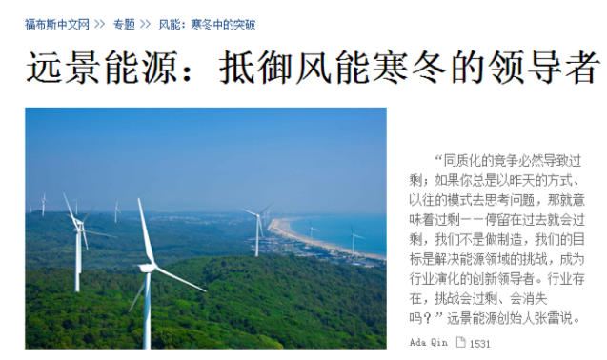
Envision was named by Forbes Magazine as a Technology Pioneer in 2009

Slide 6
Content
Envision Energy – Introduction
Global Innovation Centre, What, Why Denmark
Partner selection process – Europe / Globally
Milestones , Domistic China, ROW
How is capacity built up?
M&A – Collaborative activities
Overseas markets – Envision position and strategy

Slide 7

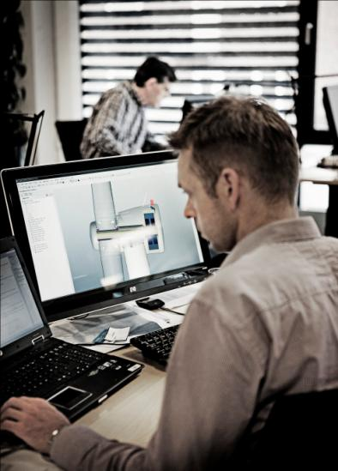
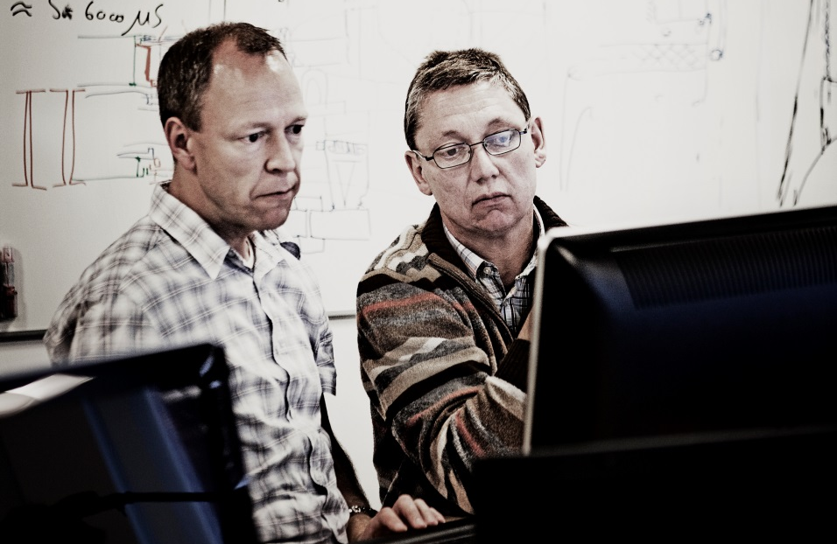
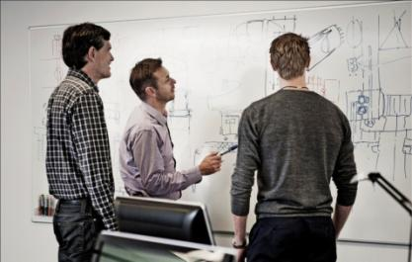
Our Global Innovation Centre has around 35 senior engineers, with average 15+ years of experience in wind

Slide 8

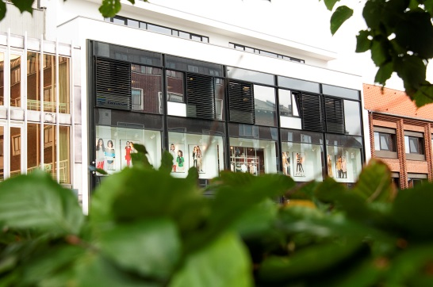
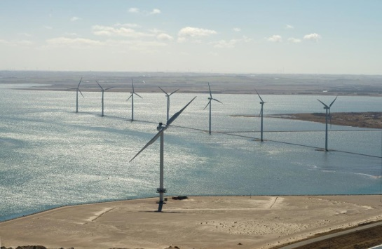
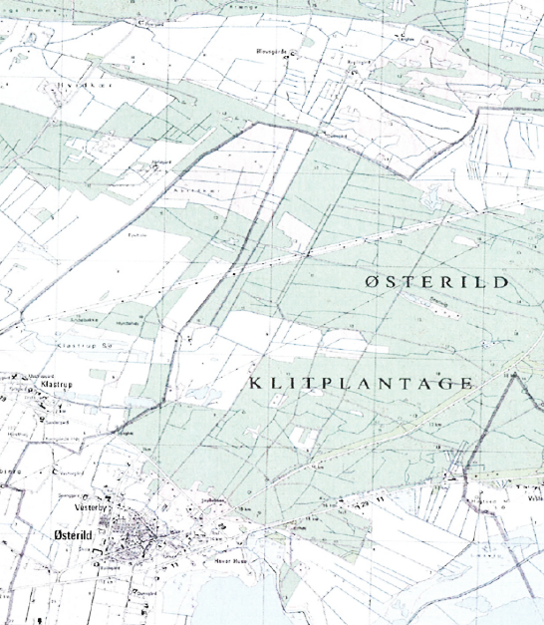
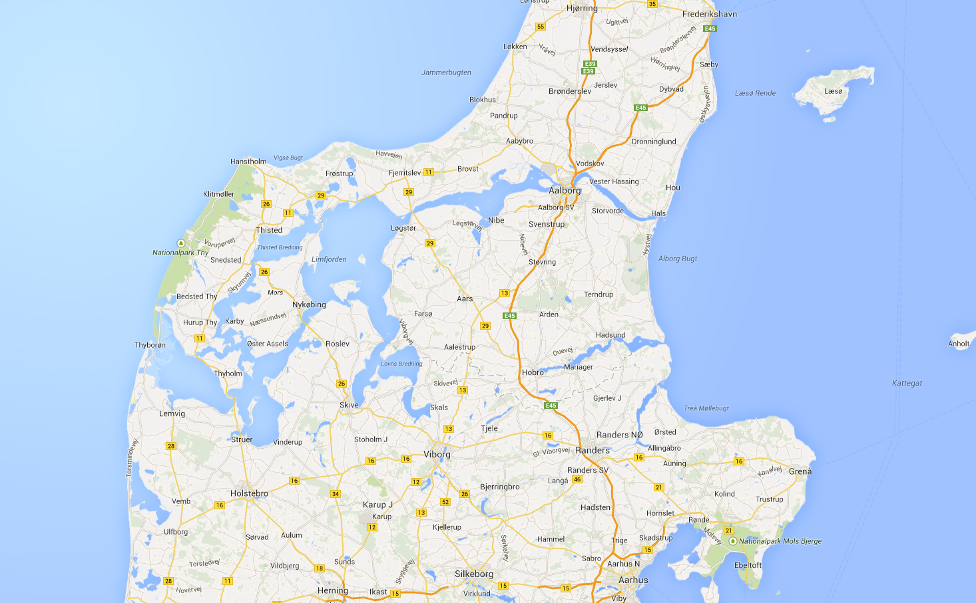
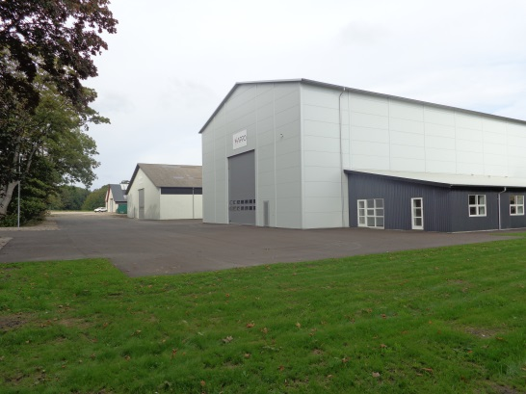
New innovative products – close to European Experience and Supply chain
Global Innovation Centre
EN-128/3.6 PP 2B
EN-120/3.0 Testsite
EN-120/3.0 Assembly hall

Slide 9
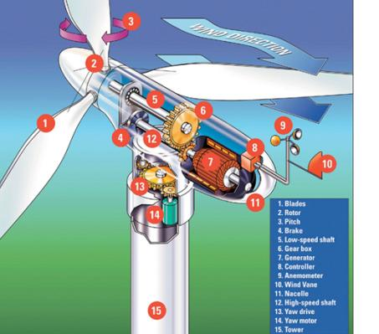
Envision Robust Design = Reliability
Voice of Customer
Voice of Engineering
Define and Develop Reliability Requirements
Robust Design for Reliability Process
Robust Optimization in the presence of uncontrollable environment
Robustness & Reliability Demonstration
Process Driven Robust Design for Reliability:
At the lowest possible cost
In shorter time
Satisfied customer
Notes:
新增页面，描述正向设计的方法论 – Dick

Slide 10
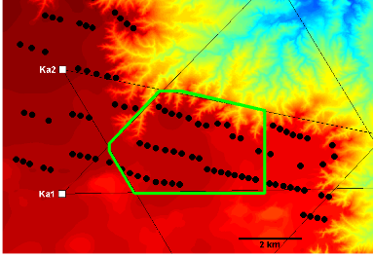
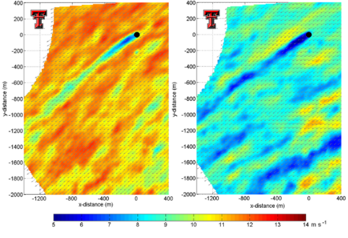

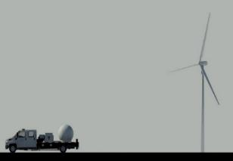
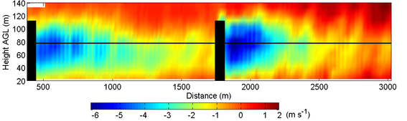
Advanced Technology
LIDAR/Radar for wind farm measurement
  Wake research
  Turbine performance mapping
  Wind farm and wake flows
  Turbine control research
2 to 5km
Two different snapshots of wakes

Slide 11


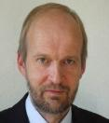

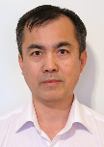



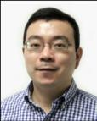
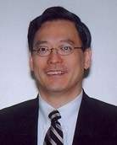
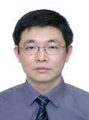




远景智能风机全球联合研发团队，拥有来自于欧洲、美国、中国的汽车、航空、飞机、半导体、风机等行业专家
Anders Rebsdorf
丹麦创新中心总经理
  前DONG能源技术总裁、前Gamesa全球技术副总裁，丹麦总经理、前Vestas技术总监
Lars Budtz
风电研发总监
  前Vestas技术总监，V80和V90的设计者
M. Mier
技术及质量总监
  前全球海上风电巨头REpower技术和质量高级副总裁
P. Grabau
叶片研发总监
  前全球第一大叶片制造商LM研发总监，开发LM 1/3的专利
孙毓平
叶片翼型专家
前波音飞机公司资深工程师
前Vestas首席工程师
M. Friedrich
系统总工
  前Vestas、Gamesa 系统总工
张峰
技术开发总监
前上海汽车高级开发总监，美国福特汽车高级控制系统工程师
刘曙源
产品开发工程副总裁
前美国福特汽车全球动力传动及整车技术群首席总监
李磊
电气研发总监
前英飞凌功率半导体部门亚太技术中心负责人 电力电子与电力系统专家
M. Christensen
机械总工
  前Gamesa, Vestas 机械总工

Slide 12
Content
Envision Energy – Introduction
Global Innovation Centre, What, Why Denmark
Partner selection process – Europe / Globally
Milestones , Domistic China, ROW
How is capacity built up?
M&A – Collaborative activities
Overseas markets – Envision position and strategy

Slide 13






Proven Offshore Suppliers
叶片
主轴承
齿轮箱
偏航变桨
轴承
发电机
变频器
主控系统
变桨系统
  Offshore Experience
  Offshore Track Record
  Pass Strict Validation

Slide 14
Content
Envision Energy – Introduction
Global Innovation Centre, What, Why Denmark
Partner selection process – Europe / Globally
Milestones , Domistic China, ROW
How is capacity built up?
M&A – Collaborative activities
Overseas markets – Envision position and strategy

Slide 15
Milestones… / Domistic China / ROW
SMART turbines
Low wind turbines
Offshore turbines
Smart Wind Farm System
Will soon be in Top 3
In China Wind market
Will soon be in Top 3
In China Offshore Wind market
ROW: Turbines in Chile. Sweden (soon). Prototypes in Denmark. Offshore…

Slide 16
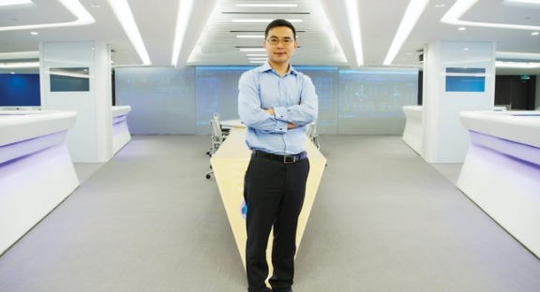
Content
Envision Energy – Introduction
Global Innovation Centre, What, Why Denmark
Partner selection process – Europe / Globally
Milestones , Domistic China, ROW
How is capacity built up?
M&A – Collaborative activities
Overseas markets – Envision position and strategy

Slide 17
Content
Envision Energy – Introduction
Global Innovation Centre, What, Why Denmark
Partner selection process – Europe / Globally
Milestones , Domistic China, ROW
How is capacity built up?
M&A – Collaborative activities
Overseas markets – Envision position and strategy

Slide 18


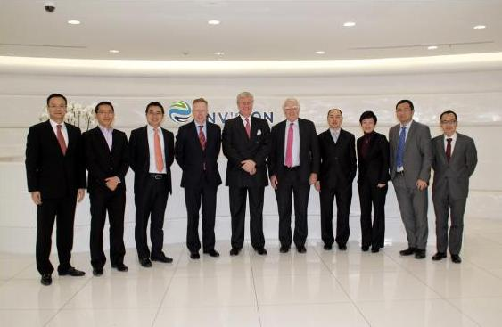




Envision Global Advisory Board
Sir Mark Stuart
Independent Board member
Ex-Chair of Shell, Current Board member of Saudi Aramco, HSBC
Shaun Independent Board member
Biggest government backed clean energy fund in Europe
CEO of Green Investment Bank
Thomas Putter
Independent Board member
One of the biggest clean energy fund
Ex-CEO of Alliance Capital, Germany

Slide 19
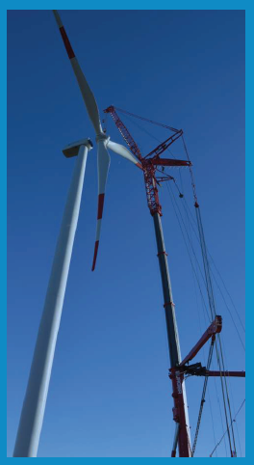
Content
Envision Energy – Introduction
Global Innovation Centre, What, Why Denmark
Partner selection process – Europe / Globally
Milestones , Domistic China, ROW
How is capacity built up?
M&A – Collaborative activities
Overseas markets – Envision position and strategy

Slide 20

Envision Energy
will strive to become a global-leading smart company in the renewable energy industry by taking challenges, attracting talent and focusing on innovation.

