Slide 1
Larsen & Toubro – A “Nation Builder”
Nordics DNA
Sarbajit Deb Executive Vice President & Chief Business Officer,
Nordic Region, LTI

Slide 2
Our Nordic Lineage
In India through partnerships with L&T
What started as a humble beginning with a small office in downtown Mumbai (then Bombay), India in 1938 by two Danish founders Henning Holck-Larsen & Soren Kristian Toubro, now is today India’s largest multi-dimensional engineering and construction company
The duo started off by marketing Danish dairy equipment but with the declaration of WWII, the engineers had to manufacture the parts themselves, thus imbibing ‘Problem Solving’ attribute in company`s DNA
Our motto from the initial years set the benchmark for customer centricity – ‘In Service Lies Success’
Over the years, the Company has set numerous engineering benchmarks in terms of speed, scale and complexity

Slide 3
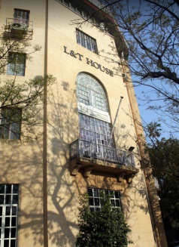
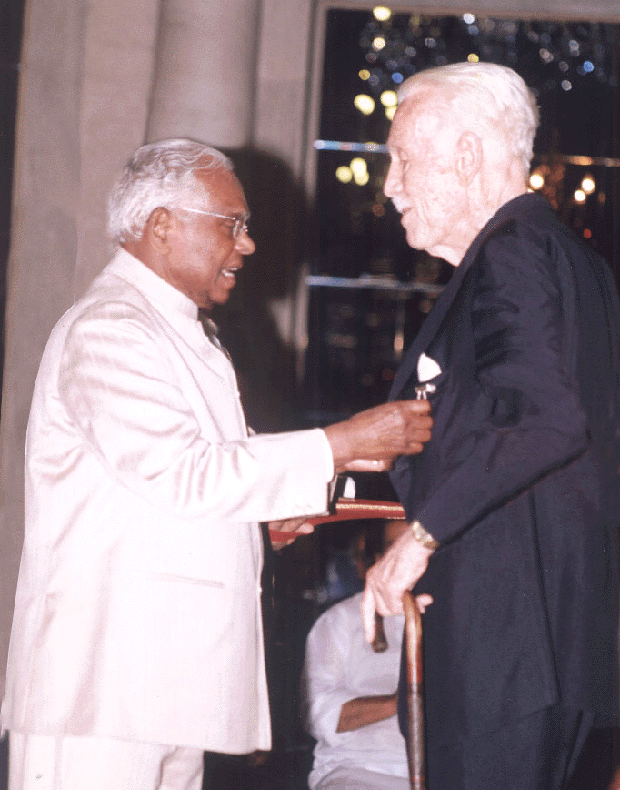
Deep roots of Denmark in India
Had his own Stamp
This is also the home of Denmark in Mumbai
Henning Holck-Larsen receives Padma Bhushan from the President of India
BTW he is also your Consul General in Mumbai

Slide 4
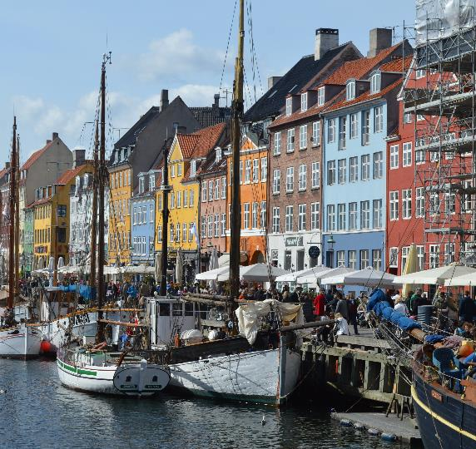
Introducing LTI
In Nordics
$1.1 Bn
17+
Years of presence in Nordics
in Revenue
25,000
Top 3
IT Services Provider in Europe
Employees
PA Consulting-White lane in 2018
300
30+
Clients
Clients
Including 59 Fortune 500 companies
23
5
Delivery Centers
Delivery Centers in Europe

Slide 5
Why LTI in Danmark?
Nordic clients are leaders in the world in almost every Industry, LTI wants to engage with the best
Happiest lot of people with great work-life balance and culture
Good availability of skilled and innovative talent pool
Innovative Star-up ecosystem
Europe's easiest place for doing business
Cost-efficient and flexible labor market
Well-connected infrastructure
World-class R&D and innovation environment
Notes:
Additional Points:
Denmark has world-class research and development facilities, an internationally competitive ICT cluster, and access to one of the most innovative talent pools
Denmark has one of the world’s biggest shipping industries despite the country’s small size and the Danish offshore industry within wind power and wave energy is at the forefront of technological development
Productive and motivated workforce

Slide 6
Challenges Faced by People & Organization
Housing shortage for teams coming in here
Long Waiting lists in English schools for children in a Danish System or International systems.
Visa Restriction on children of 18 years and above who needs to come on tourist visa to accompanying parents
Danish Language for doing business with Government bodies / Public sector and Tenders in Danish
Free Hiring of employees who are engaged in projects with Danish companies

