Slide 1
EMERGING MARKETS INSTITUTE
Encouraging Dialogue, Building Bridges
Lourdes Casanova Gail and Rob Cañizares Director, Emerging Markets Institute
October 2021
Cornell SC Johnson College of Business 1

Slide 2
Channels Political influence in business
Ownership: SOEs here to stay
Industrial policies
FDI versus OFDI
Covid packages
Internationalization and Trade agreements
Currencies/Technology Decentralized Finance (Defi)
Bitcoins
CBDC
Change of paradigm: from Reagan to Biden
So what for IB? Need to go beyond the dogma

Slide 3
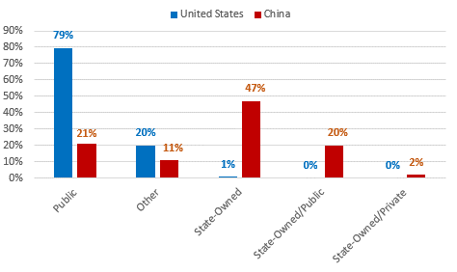
Ownership of 100 biggest U.S. and Chinese companies (2019 Fortune Global 500)
79% of U.S. companies are public versus only 21% in China, while 47% of the Chinese companies are state-owned versus only 1% of the U.S. companies
Source: EMi research team based on data from Fortune Global 500 2019 and CapitalIQ. Casanova and Miroux 2019 https://ecommons.cornell.edu/handle/1813/66953

Slide 4
EMI CONFERENCE 2021
Emerging Market Multinationals, building the future on ESG excellence
https://cvent.me/9KgDKV
emiconference@cornell.edu
Cornell SC Johnson College of Business 4

Slide 5
THANK YOU
https://www.johnson.cornell.edu/emerging-markets-institute/
https://ecommons.cornell.edu/handle/1813/66953
Lourdes Casanova Gail and Rob Cañizares Director, Emerging Markets Institute

