Slide 1
Toward a Political Global Strategy: From Institutions to Emerging Markets to Politics
Alvaro CUERVO-CAZURRA
Northeastern University
a.cuervocazurra@neu.edu
Panel on What should we know about EMNCs and the politics of internationalization
7th Copenhagen Conference on Emerging Market Multinationals: Outward Investment From Emerging Economies
14 October 2021

Slide 2
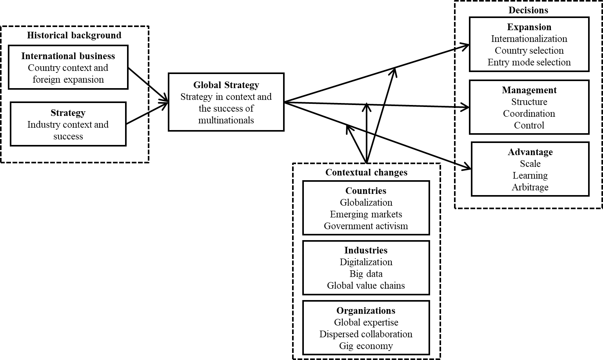
Toward a Political Global Strategy (PGS)
Global Strategy
Strategy in context
See an overview in Tallman, S., & Cuervo-Cazurra, A. 2021. Global strategy. Duhaime, I., Hitt, M., Lyles, M. (eds). Strategic Management: State of the Field and Its Future. Oxford: Oxford University Press.
Political Global Strategy
Politics as the driver of strategy in context
Indirect influence in the context of operation
Direct influence in strategies
Evolution of a political global strategy
(PGS 1) From institutional global strategy
(PGS 2) To emerging markets global strategy
(PGS 3) To a political global strategy

Slide 3
(PGS 1) From Institutional global strategy
Institutions:
Norms and rule of behavior that support market transactions (formal as laws and regulations, and informal as culture) (North, 1990)
Evolution of literature
From psychic distance (Johansson & Vahlne, 1977) to cultural differences (Kogut & Singh, 1988) to institutional differences (Khanna & Palepu, 1997; Meyer et al., 2009; Peng, 2002)
Influence of government on global strategy
Indirect: context for firm investment
Political strategies
Constraints on internationalization: country selection and entry mode for adaptation to the conditions of the context (Henisz, 2000; Kostova & Zaheer, 1999) and learning from home country (Cuervo-Cazurra & Genc, 2008)

Slide 4
(PGS 2) To emerging markets global strategy
Emerging markets
Countries with lower economic and institutional development
Evolution of literature
From low-cost locations to growing markets to new competitors (Ramamurti & Singh, 2009), challenging models of the multinational (Cuervo-Cazurra, 2012)
Influence of government on global strategy
Indirect: context for firm innovation and direct: escape
Political strategies
Benefits and liabilities drive competitiveness: access to endowments (Narula, 2012), low-cost innovation (Govindarajan & Ramamurti, 2011; Prahalad, 2005; Zeng & Williamson, 2007), escape internationalization (Barnard, 2014; Witt & Lewin, 2007)

Slide 5
(PGS 3) To political global strategy
Politics
Management of decision-making in society
Evolution of literature
Bargaining with government (Vernon, 1971; Ramamurti, 2001) to government as driver of internationalization (Luo, Xue & Han, 2010), especially of state-owned firms (Cuervo-Cazurra, Inkpen, Musacchio & Ramaswamy, 2014)
Influence of government on global strategy
Direct: support for foreign expansion (subsidies, diplomacy) especially for state-owned firms
Political strategies
Government-based advantage: Direct influence on political decision making (lobby, finance, pressure) (Hillman & Hitt, 1999); dark side as corruption (Cuervo-Cazurra, 2006)

Slide 6
Conclusion: Toward a Political Global Strategy
From global strategy to political global strategy: Institutions, emerging markets, and politics
Government influence on global strategy from indirect (context) to direct (support)
Political strategies from adaptation (constraints on internationalization) to innovation (benefits and liabilities in internationalization) to negotiation (advantages in internationalization)

Slide 7
Toward a Political Global Strategy: From Institutions to Emerging Markets to Politics
Alvaro CUERVO-CAZURRA
Northeastern University
a.cuervocazurra@neu.edu
Thank you for your attention!

