Slide 1
EMERGING MARKETS INSTITUTE
.
ESG and Emerging Market Firms
Anne Miroux
Faculty Fellow, EMI
Cornell University
7TH Copenhagen Conference on Emerging Market Multinationals: Outward Investment From Emerging Economies
Copenhagen Business School
14 October 2021

Slide 2
EMERGING MARKETS INSTITUTE
Cornell SC Johnson College of Business 2

Slide 3
EMI: EDUCATION, OUTREACH, KNOWLEDGE
Education
Outreach
Knowledge
Conference Nov. 5:
http://www.emiconference.com
Emerging Market Multinationals, building the future on ESG excellence
5th Case Competition : Africa firm going global
Second Pitch competition
Blogs/ Social Media/ Newsletter/ EMI fellows Alumni
L. Casanova
Anne Miroux
Emerging Market Multinationals Report 2020 10 years that changed emerging markets
We monitor E20, the biggest emerging Markets and also emerging multinationals
Case Studies
EMI Fellows: 2nd Year Concentration/Intensive
10% of the class follow a ‘concentration’ on Emerging Markets
Cornell Tech and eMBA students have joined
Cornell SC Johnson College of Business 3

Slide 4
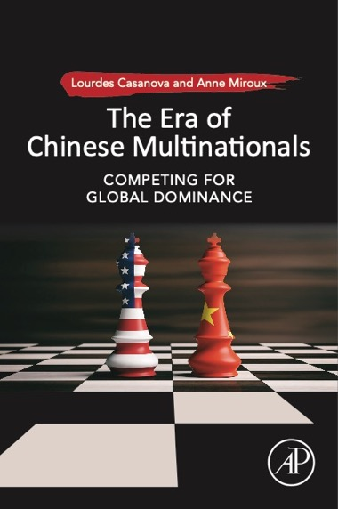
Casanova, L.; Miroux, A. Emerging Markets Multinationals Report. 2016-2017-2018- 2019-2020 . ISSN 2689-0127 https://ecommons.cornell.edu/handle/1813/66953
http://bit.ly/bookchina
EMI RESEARCH TEAM 2021
Including
Daniel dos Anjos, lead Research Assistant
Vineetha Pachava
Mihika Badjate
Vritika Patni
EMI interns
https://ecommons.cornell.edu/handle/1813/66953
Lourdes Casanova, Anne Miroux
2016: The China Surge
2017: Emerging Multinationals in a Changing World
2018: Reshaping Globalization
2019: Constructive engagement
2020: 10 years that changed emerging markets
2021: Emerging Market Multinationals, building the future on ESG excellence www.emiconference.com
Notes:
4

Slide 5
EMERGING MARKETS INSTITUTE
Cambridge University Press - 2021
A Global Project
18 contributors from 3 continents - 8 different countries

Slide 6
1
Introduction – EMR 2021
AGENDA
2
Working on data
Emerging Market Multinationals,
building the future on ESG excellence
3
ESG Databases
4
Methodology
5
Results
Cornell SC Johnson College of Business 6

Slide 7
INTRODUCTION
Cornell SC Johnson College of Business 7

Slide 8
The Emerging Market Report (EMR) 2021 will be launched at the EMI conference on November 5th
2021 EMR Theme
Top EM firms
Emerging Market Report
Emerging Market Report’s goal is to look for insights into emerging countries and the performance of emerging market multinationals, comparing their performance with the rest of the world
Environmental, Social, and Governance: an opportunity for Emerging Multinationals
according to their ESG performance
Cornell SC Johnson College of Business 8

Slide 9
2021 EMR : Emerging Market Multinationals, building the future on ESG excellence
Redefining E20 ➔ China + E20
Focusing on Regional data
Confirming leadership of China in Emerging Market Multinationals (eMNCs)
At the expense of other firms from the rest of Emerging Markets
Shift to Asia
ESG : 2021 theme
overall chapter and specific contributions

Slide 10
SHIFTING BUSINESS LANDSCAPE
Cornell SC Johnson College of Business 10

Slide 11
China’s prominent role, surpassing U.S. in number of firms not total revenue, Fortune Global 500, 2021
Source: Daniel Ribeiro dos Anjos and EMI research team based on Fortune (https://fortune.com/), accessed in August 2021.

Slide 12
China’s MNCs growth versus other Emerging Markets, Fortune Global 500, 2021
China’s firms have grown versus the U.S. and other Emerging Countries
GFC
* It does not include South Korea and Poland, considered emerging countries on previous EMI reports
Source: Daniel Ribiero dos Anjos and EMI research team based on Fortune (https://fortune.com/), accessed in August 2021.

Slide 13
ESG in EMR 2021
Cornell SC Johnson College of Business 13

Slide 14
ESG in the EMR 2021
ESG concept: background and origin
ESG and emerging markets: policy issues
ESG assessment exercise for EMR 2021
ESG assessment challenges in emerging markets

Slide 15
Environmental
Social
Governance
Climate Change (carbon emissions, etc.)
Natural capital (biodiversity, water management, land use, etc.)
Waste and recycling
Energy efficiency
Human rights
Human resources management (labor relations, etc.)
Diversity
Health and Safety
Product liability
Responsible marketing and R&D
Community relations
CorporateGovernance (ownership and control, decision making processes, accountability, etc.)
Corporate behavior (bribery and corruption, transparency, etc.)
Cornell SC Johnson College of Business 15
Source: Robeco (www.robeco.com), accessed May 2021

Slide 16
STEP 1: List of emerging market firms
Cornell SC Johnson College of Business 16

Slide 17
Criteria and database
The database used is S&P Capital IQ (fast unlimited screening, convenient functionalities, better coverage of emerging market multinationals)
Companies and subsidiaries
Companies with International Securities Identification Number (ISIN) only*
The filter excludes government institutions (i.e., countries, municipalities), private investment firms, religious institutions, funds, and others
Revenues > US $1 billion*
Headquartered in an emerging country**
Based on 2021 EMR E20 criteria definition (exclude about 40 countries with highest GDP per capita)
* Mostly publicly quoted companies, but some private or mixed ownership (SOE/public companies), based on S&P Capital IQ’s classification of company types (accessed March 31, 2021)
** Headquarter of the ultimate parent company, according to Bureau van Dijk’s Orbis; Macau and Hong Kong are included under China
Cornell SC Johnson College of Business 17

Slide 18
Company Overview
Starting List: 2,271 companies with ISIN from an initial list of about 8,000 firms, from 49 countries
 | Country | E20 | No. of Companies | Share of the total
1 | China | ✅ | 1,266 | 56%
2 | India | ✅ | 181 | 8%
3 | Russia | ✅ | 106 | 5%
4 | Brazil | ✅ | 93 | 4%
5 | South Africa | ✅ | 74 | 3%
6 | Thailand | ✅ | 61 | 3%
7 | Mexico | ✅ | 58 | 3%
8 | Malaysia | ✅ | 48 | 2%
9 | Indonesia | ✅ | 45 | 2%
10 | Turkey | ✅ | 44 | 2%
11 | Philippines | ✅ | 42 | 2%
12 | Saudi Arabia | ✅ | 35 | 2%
13 | Chile | ✅ | 30 | 1%
14 | Poland | ✅ | 28 | 1%
15 | Vietnam |  | 24 | 1%
16 | Colombia | ✅ | 19 | 1%
17 | Argentina | ✅ | 17 | 1%
18 | Ukraine |  | 11 | 0%
19 | Egypt | ✅ | 9 | 0%
20 | Peru |  | 9 | 0%
Cornell SC Johnson College of Business 18

Slide 19
Company Overview
20 biggest of 2,271 companies
 | Company | Country | Revenues (S mm)
1 | China Petroleum & Chemical Corporation* | China | 322,578
2 | PetroChina Company Limited* | China | 296,210
3 | Saudi Arabian Oil Company | Saudi Arabia | 229,799
4 | China State Construction Engineering Corp* | China | 203,915
5 | Ping An Insurance (Group) | China | 190,604
6 | China Railway Group Limited* | China | 149,304
7 | China Railway Construction Corporation* | China | 139,436
8 | China Life Insurance Company Limited* | China | 124,396
9 | Public Joint Stock Company Gazprom | Russia | 123,370
10 | China Mobile Limited* | China | 117,647
11 | JD.com, Inc. | China | 114,236
12 | SAIC Motor Corporation Limited* | China | 113,674
13 | China Communications Construction Comp | China | 96,129
14 | CITIC Limited* | China | 93,019
15 | Industrial and Commercial Bank of China | China | 91,506
16 | The People's Insurance Company of China | China | 89,105
17 | China Construction Bank Corporation | China | 79,762
18 | Reliance Industries Limited | India | 79,249
19 | China Evergrande Group | China | 77,696
20 | PJSC LUKOIL | Russia | 74,471
Cornell SC Johnson College of Business 19
* According to Capital IQ, subsidiaries of another company, not always a public parent with independent ISIN

Slide 20
Step 2: ESG Databases
Cornell SC Johnson College of Business 20

Slide 21
Several databases were examined.
Six different ESG sources downloaded from Bloomberg (through Cornell Library).
1.Bloomberg ESG Disclosure (BLOO)
2.Sustainalytics ESG Risk rating (SUSB)
3.S&P ESG Risk rating (SPRS)
4.Bloomberg Gender-Equality Index from Bloomberg (BGEI)
5.ESG Improvers Index from Bloomberg (BIMP) (US & Canada)
6.Arabesque (ARBQ) (limited access)
Two ESG sources downloaded from Factset
FTSE Russell ESG (FTFA)
Sustainalytics Rank ESG (SUSF)
Cornell SC Johnson College of Business 21

Slide 22
Four other ESG sources data downloaded from Wind, a Chinese financial information services company . Wind covers in particular Chinese headquartered companies.
Wind Sino-Securities Index from Wind (WSSI)
FTSE Russell ESG from Wind (FTWI)
SynTao ESG from Wind (STAO)
CASVI ESG from Wind (CASV)
(China Alliance of Social Value Investment)
Three other ESG sources, downloaded from different databases available at Cornell University Library
Thomson Reuters Refinitiv ESG Combined (REFT).
MSCI ESG from MSCI Direct (MSCI)
S&P Global ESG Score from Market Intelligence (SPMI)
One source was downloaded for knowledge and information : Global Compact Signatories

Slide 23
Benchmark
BIMP, only US and CA firms
WIND, special access
BLOOMBERG TERMINAL
FACTSET
WIND
 | BLOO (Bloomberg ESG) | SUSB (Sustainalytics) | SPRS (S&P Rank) | BGEI (Gender Equality) | BIMP (Improvers) | ARBQ (Arabesque) | FTFA (FTSE) | SUSF (Sustainalytics) | WSSI (Sino Index) | FTWI (FTSE) | STAO (SynTao) | CASV (CASVI) | REFT (Refinitiv) | MSCI | SPMI (S&P) | GC (Global Compact)
Downloaded | Y | Y* | Y* | Y* | N* | N** | Y | Y | Y* | Y | Y | Y | Y | Y | Y | Y
Share of the starting list | 71% | 10% | 44% | 1%* | NA* | ▬ | 31% | 12% | 38% | 27% | 35% | 15% | 53% | 46% | 13% | ~10%
E/S/G can be disaggregated | ✅ | ✅ | ✅ | ▬ | ▬ | ▬ | ▬ | ✅ | ▬ | ▬ | ▬ | ▬ | ✅ | ✅ | ✅ | ▬
Comparable industries | ✅ | ✅ | ✅ | NA | NA | ✅ | ✅ | ✅ | ▬ | ✅ | ▬ | ▬ | ✅ | ✅ | ✅ | ▬
Rating Format*** | 0 / 100 | 1 / 100 | 1 / 100 | 1 / 100 | NA | 1 / 100 | 0 / 5 | 100 / 0 | C / AAA | 0 / 5 | D / A+ | D / AAA | 0-100 | 0-10 | 0 / 100 | ▬
Assesses Performance | ▬ | ✅ | ✅ | ✅ | ✅ | ✅ | ✅ | ✅ | ✅ | ✅ | ✅ | ✅ | ✅ | ✅ | ✅ | ▬
Controversies mentioned | ▬ | ✅ | ▬ | ▬ | ▬ | NA | ▬ | ✅ | ▬ | ▬ | ✅ | ▬ | ✅ | ✅ | ✅ | ▬
Directly accessed | ✅ | ▬ | ▬ | ✅ | NA | NA | ▬ | ▬ | ▬ | ▬ | ▬ | ▬ | ✅ | ✅ | ✅ | ✅
Available at Cornell | ✅ | ✅ | ✅ | ✅ | NA | ▬ | ✅ | ✅ | ▬ | ▬ | ▬ | ▬ | ✅ | ✅ | ✅ | ✅
* Not considered because they don’t cover eMNCs or we had no access (Arabesque, Improvers). SUSB and SPRS correlates more with bloo than SUSF or SPMI. BGEI only 1%.
** Limited access through the available sources at Cornell or not subscribed
Cornell SC Johnson College of Business 23

Slide 24
ESG Databases
List of ESG databases used in the analysis:
Bloomberg ESG Disclosure (Bloomberg)
FT Russel ESG (Factset)
Sustainalytics ESG (Factset)
Syntao ESG (Wind)
CASVI (Wind)
Refinitiv
MSCI ESG (MSCI Direct)
S&P global ESG (Market Intelligence)
Cornell SC Johnson College of Business 24

Slide 25
Methodology
Cornell SC Johnson College of Business 25

Slide 26
ESG Rating calculation`
Standardization of the measurement range, from 0 to 100
Calculating the rating as a simple average
Sorting the companies according to score
Excluding companies missing more than 3 sources.
Filtering the top 250
Cornell SC Johnson College of Business 26

Slide 27
RESULTS
Cornell SC Johnson College of Business 27

Slide 28
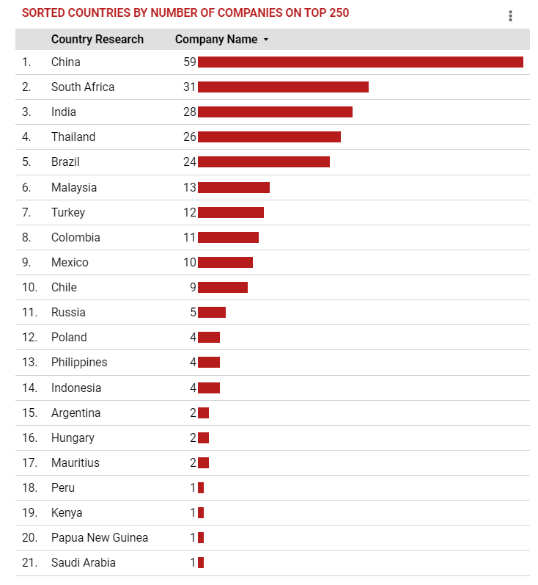
Results (work in progress)
…
Cornell SC Johnson College of Business 28
Notes:
Enter the slide title in the first text box
Enter any subtext you would like in the second text box – delete this text box if not in use
Enter the topic headline and your bulleted list in each box

Slide 29
Results (work in progress)
Preliminary results
China’s share in the top 250 is less than could have been expected, given its very important presence in the initial sample.
The cases of Thailand and South Africa are interesting; they are very well positioned in spite of a small share in the original sample. Chile and Colombia are also doing comparatively well.
Putting things in perspective
Rating systems
Disclosure and reporting in emerging markets
The role of contextual factors
Assesment challenges – rating systems and contextual factors
Cornell SC Johnson College of Business 29

Slide 30
. THANK YOU
https://www.johnson.cornell.edu/emerging-markets-institute/
.
https://ecommons.cornell.edu/handle/1813/66953
Lourdes Casanova
Anne Miroux
And EMI research team
Lead by Daniel dos Anjos
Guatam Jain
Felipe Saenz
Vineetha Pachava
.
.
Cornell SC Johnson College of Business 30

