Slide 1
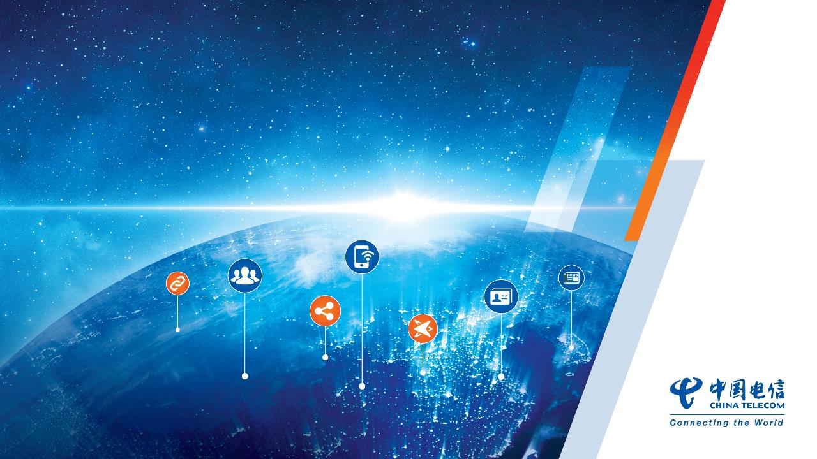
CTE（China Telecom Europe） Update
Jing Cui
Chief Representative Denmark
E-mail: cuijing@chinatelecomglobal.com
http://www.cteurope.net

Slide 2

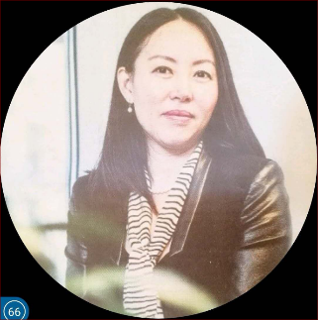
Jing Cui
Chief Representative Denmark
E-mail: cuijing@chinatelecomglobal.com
Address: Regus Tuborg boulevard 12, F3. 2900 Hellerup, Denmark
http://www.cteurope.net
18 years in ICT Industry globally
Live in Denmark since Y2007

Slide 3
Agenda
About China Telecom
About China Telecom Global
CTG/CTE Value Proposition
Diversified Products and Services

Slide 4

About
China Telecom

Slide 5



Our Revenue & Subscribers
World’s largest
World’s largest
Revenue & Profit
4G LTE FDD mobile operator with
broadband operator with
12.77 Billion
Euro
265.3M
137.29M
Mobile
subscribers
including
Wireline
Broadband
subscribers
200.26M
including
Operating Revenue
2.46
Billion Euro
130.17M
4G
subscribers
Optical
Fiber
subscribers
Profit
World’s largest
Total Assets
87.41 Billion Euro
Access Lines operator
600K Employees
120.88 Million
Access Lines in Service
*Source: Q1, 2018 Result
**Source: 2017 Annual Result
Notes:
China Telecom Global
Offers supply chain benefits by consolidating the capability of 31 provincial mainland China companies.
In addition to adding its Global capability.

Slide 6
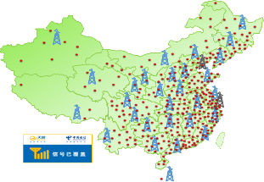
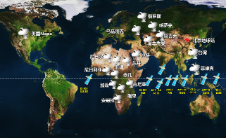
Network Capabilities Forging Core Competitive Edge
Fiber-Optical Networks
230,000 km
Mobile Network Coverage >98%
伊宁
齐齐哈尔
乌鲁木齐
白城
哈尔滨
牡丹江
安西
阜新
长春
延吉
包头
呼和浩特
张家口
北京
秦皇岛
沈阳
丹东
武威
银川
榆林
保定
石家庄
天津
大连
Optical Network Port
330 Million
FTTH Coverage >92%
4G Base Stations
1.17M
4G Coverage >98%
格尔木
西宁
兰州
太原
济南
青岛
徐州
连云港
拉萨
西安
合肥
南京
上海
成都
重庆
武汉
杭州
宁波
贵阳
长沙
南昌
昆明
南平
福州
南宁
深圳
汕头
International Submarine
/Terrestrial Cables
> 43
Connecting Countries/Regions
> 72
International Capacity
> 30Tbps
Data Centres
> 400

Slide 7
China Telecom Corporate Strategy
Transformation 3.0
Three Goals
Develop the Strong Network
Build the World-Class Enterprise
Create a Better Future Together
Transformation 2.0
Transformation 1.0
Leader of Intelligent Pipeline
Provider of Integrated Platforms
Participant of Content & Application Development
Network Intelligentization
Service Ecologicalization
Operation Intellectualization
Telecom Full Service Provider
Internet Applications Aggregator
Leading Enterprise ICT Service Provider
Three Missions
Build the Next-Generation Intelligent Information Infrastructure
Promote the Information Industrial Convergence
Improve the Total-Factor Productivity
Integrated Information Service Provider
Leading Integrated
Intelligent Information Service Provider
2004
2011
2016
Internet Era
Mobile Internet Era
Intelligence Era

Slide 8

About
China Telecom Global

Slide 9

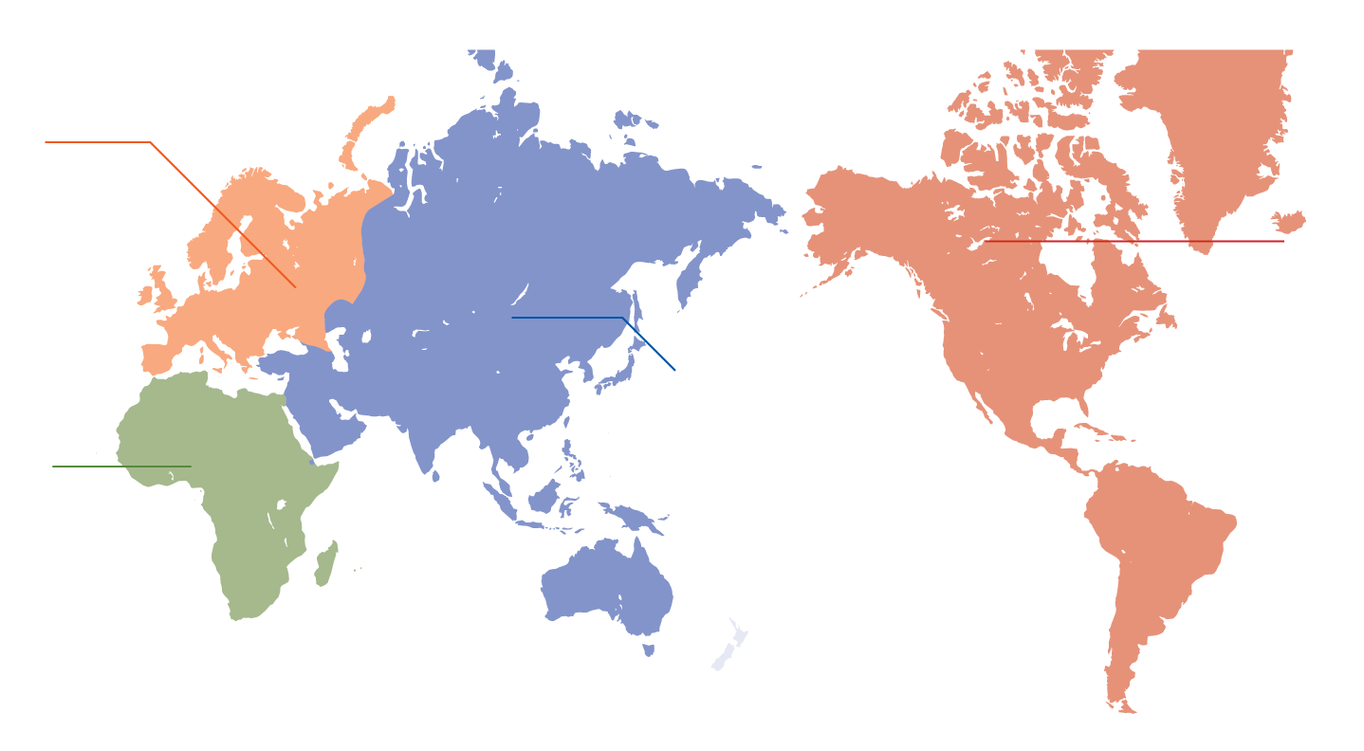
Headquarters, Subsidiaries and Affiliates
Extensive Global Network
Headquartered in Hong Kong and Beijing, China Telecom Global has established subsidiaries and affiliates in
35countries and regions around the world
Europe
United Kingdom ⁽²⁾
France
Germany
Russia
Belarus
Spain
Austria
Italy
Turkey
Czech Republic
Poland
Sweden
Denmark
Americas
United States ⁽²⁾
Brazil
Canada
Ecuador
Asia Pacific
Hong Kong ⁽¹⁾
Australia
Indonesia
Kazakhstan
Malaysia
Pakistan
South Korea
Thailand
Beijing ⁽¹⁾
India
Japan
Macau
Myanmar
Singapore
Sri Lanka
Vietnam
Africa &
Middle East
Mauritius ⁽²⁾
Kenya
South Africa
United Arab Emirates
Corporate Headquarters (2) Regional Headquarters
Projects and services are offered in compliance with all applicable international laws and regulations including restrictions on the provision of goods and services or financial transactions which may apply.

Slide 10

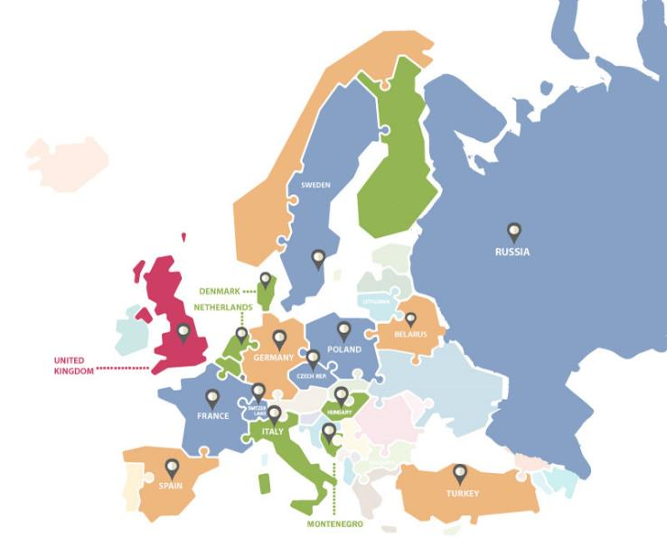
Presence In Europe
Extensive Global Network
28
16
PoPs in countries and regions in Europe
Regional Headquarters in United Kingdom
France
Germany
Netherlands
Spain
Switzerland
Denmark
Italy
Czech Republic
Sweden
Montenegro
Hungary
Poland
Turkey
Belarus
Russia

Slide 11
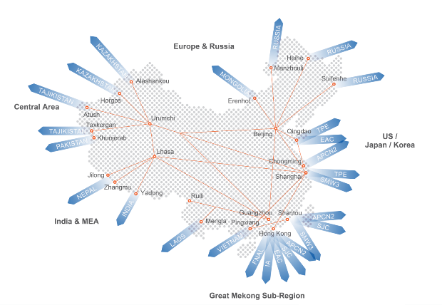

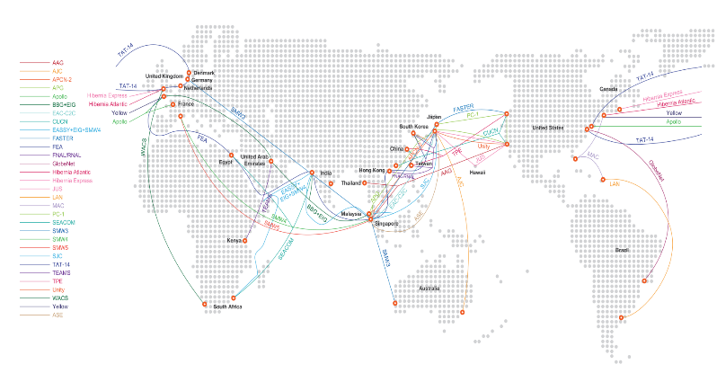
Global Information Highway Network
Actualized the Belt & Road Initiative
Our global network consists of 43 submarine & terrestrial cables, delivering a total 30Tbps international bandwidth
China-Kazakhstan Cable
China-Kyrgyzstan Cable
China-Tajikistan Cable
China-Nepal Cable
China-Russia Cable
China-Mongolia Cable
China-Vietnam Cable
China-Myanmar Cable
China-Laos Cable
Shenzhen-Hong Kong Cable
Zhuhai-Macau Cross-Border Cable
Notes:
如何打造“全球信息高铁”？中国电信提出：云网融合，布局全球。
第一、在“一带一路”的核心区域和欧美重点国家投入云计算基础资源，为企业的海外业务落地提供坚实的基础保障。目前中国电信国际公司已在海外20个节点具备云计算服务提供能力，云资源整体布局已覆盖“丝绸之路经济带”、“21世纪海上丝绸之路”沿线的主要城市。对于“走出去”的企业来说，海外多点部署的云节点，不仅仅是业务网络的转接点，同时也是关键运营数据的安全承载点、文化辐射的业务分发点。
第二、中国电信国际公司2014年在海外率先建成一张数据中心互联专网，目前已经覆盖了亚太和欧美中国电信主要的数据中心节点。
第三、通过强大的产业链整合能力，共同营造开放、高效协同的产业生态圈，提供更完善的云服务

Slide 12

Euro-Asia Network Solution
Extensive Global Network
CR2
Stockholm
Helsinki
TEA2
Moscow
Transit Mongolia
TEA
London
Düsseldorf
TEA
TEA2
TEA4
Amsterdam
Frankfurt
Heihe
TEA4
Paris
Transit Silk Road
CR2
Milan
Erenhot
Vladivostok
Transit Mongolia
Madrid
Istanbul
Khorgos
Transit Silk Road
SMW3
SMW5
Cairo
Hong Kong
European Backbone
Dubai
Singapore

Slide 13
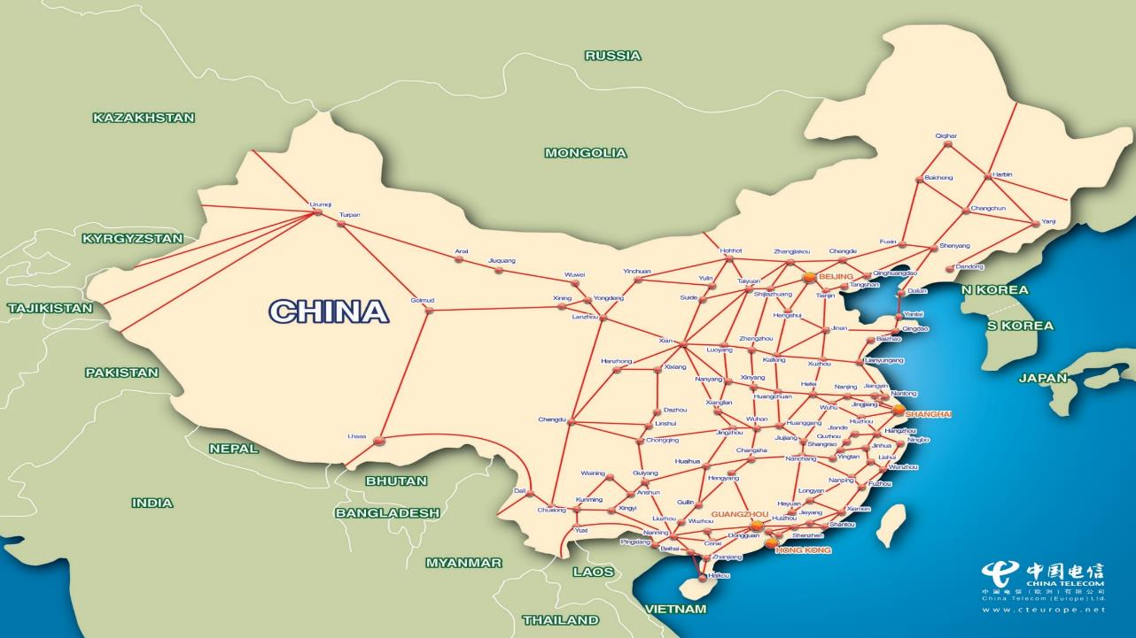


TEA
Transit – Kazakhstan
Transit – Kazakhstan
Transit – Mongolia
CR2
China – Kyrgyzstan
China – Tajikistan
China – Pakistan
APCN2
CUCN
SMW3
TPE
AGI
APCN2
CUCN
SMW3
China – Myanmar
China –
Laos
China
– Vietnam

Slide 14
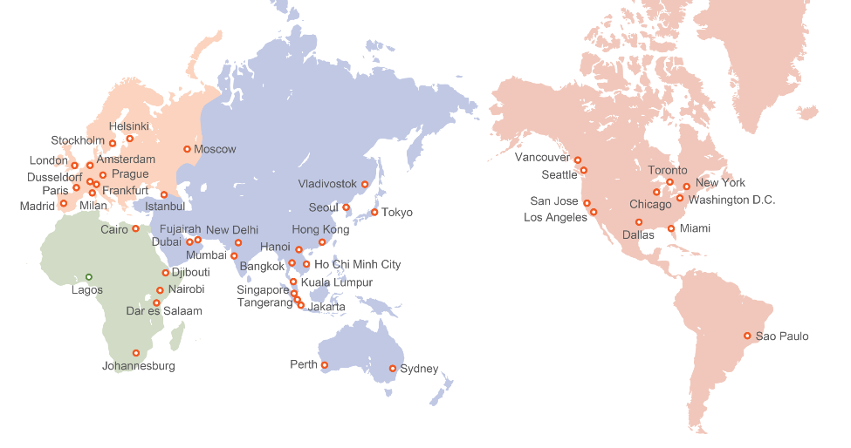


Global Points of Presence
Extensive Global Network
68
35
PoPs in countries and regions around the world
More than backbone nodes in China with
an operating capacity of
300
12,000G
CTG’s network reaches all financial centres.
Projects and services are offered in compliance with all applicable international laws and regulations including restrictions on the provision of goods and services or financial transactions which may apply.

Slide 15

Value
Proposition

Slide 16

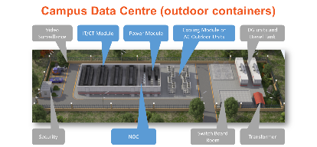
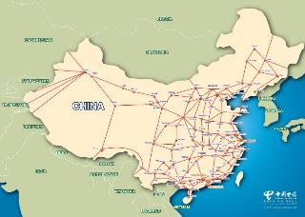
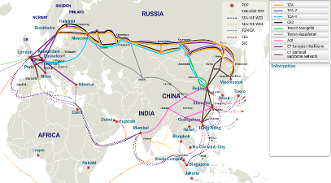

Value Proposition
One Stop Shop (supply chain benefits)
    Install, manage and bill, both mainland China* and International services, governed by one multi-service contract
Customer Alignment
    Cultural / Language: Native Chinese and European speaking staff
    Same Time Zone: Local support available in China, Europe .. 24x7x365
    Flexible Billing: China local bill (CNY) or in Europe (USD, EURO, SEK, GBP ..) or combination of both
Size, scale, financial stability
    Largest ICT & Telecoms provider in China
    Listed in NYSE (CHA) & HK stock market HKEx (728)
  * Mainland China is served by 31 China Telecom provincial companies
ICT - Wi-Fi, Data Centre containers, LAN, cabling, bespoke ICT builds etc
China Network Services
Global Network Services

Slide 17



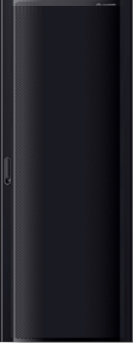







One Stop Shop (connectivity, data centre, equipment & maintenance …)
PSTN
WAN
Internet
Uses the standard and modular design to be compatible with industry standards.
Standardization
Router
Office work
Switch
Firewall
Pre-integrates retail office work and service software to implement integrated ICT deployment.
Pre-integration
Server
ACS
Monitoring unit
PDU
POS
Call center
ERP
CRM
Headquarters: remote surveillance
Distribution box
Unified O&M
Manage One
Management software
Surveillance
UPS
Headquarters O&M center
Battery
Management
Branch Office: simplified O&M and reduced labor costs
MicroDC

Slide 18

Diversified
Products
and Services

Slide 19








Products & Services
Diversified Products and Services
Voice Wholesale
ITFS / UIFN
Global PBX
SIP Trunk
Intl 4008
IDD
Cloud Conference
IPX
VPC
Cloud Storage
Cloud Backup
Cloud Desktop
Mobile Roaming
Multi-SIM
WiFi Roaming
Mobile WiFi
MVNO
China Virtual Number
UC&C
Cloud
Mobile
IPLC
IEPL
MPLS VPN
IPSEC VPN
VLL
VPLS
Wavelength
Cable Restoration
Managed WAN
Managed Security
Managed IPT
Video Conferencing
Retail
Content & Media
Logistics
Property
Bandwidth
Application
Solutions
Vertical
Industry
Solutions
GIA
Global Transit
Paid Peering
China Access
Anti DDOS
Colocation
VIP Room
Remote Hands
Hardware Management
Software Management
Networking
IP
Data
Center

Slide 20



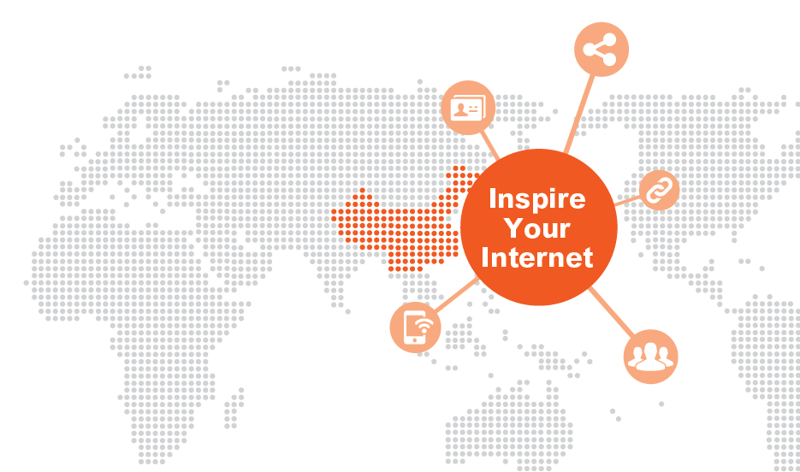

Global Internet Service
Diversified Products and Services
World’s largest
World's most extensive network of Chinese Internet information,
network with the most Internet users,
2.3M
with more than Chinese websites
123M
broadband subscribers, and
400
and over IDCs in mainland China
122M
4G terminal users
Source: 2016 Annual Results Announcement of China Telecom Corporation Limited

Slide 21




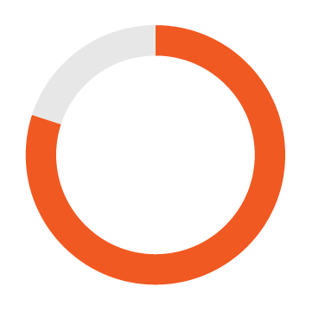







World Class Internet Data Centers
Diversified Products and Services
Operating more than overseas self-built data centers and
6
15
partnering with more than data center operators,
Beijing
Yongfeng, Zhaowei
Nanjing
Hexi
Wuxi
New District
Suzhou
Jinji Lake
China Telecom manages more than international or
regional data centers with extensive operation experience
50
CT has
80%
of market share
in mainland China
Shanghai
Information Park
Hangzhou
Xingyi
Xiamen
Software Park
Shenzhen
Longgang, Shahe,
Fuyong
5 stars standard
Experienced staff with BCI Certification
ISO27001 and ITIL
Guangzhou
APIE
Chengdu
Western
Information Center
Inner Mongolia
Cloud Computing Park

Slide 22

CONNECTING THE WORLD
Xie Xie!
Thank You!
CHINA TELECOM GLOBAL LIMITED
www.cteurope.net
This document is provided for informational purposes only and is subject to change without notice.
It should not be relied on for any other purposes.

