Slide 1
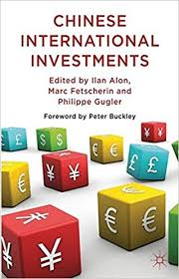
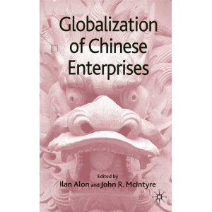
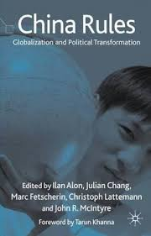
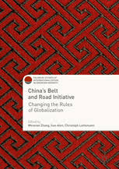
Political and Institutional Determinants of Chinese MNCs
Ilan Alon, Ph.D.
Professor of Strategy and Int Marketing, UiA, Norway
Editor, International Journal of Emerging Markets
Editor, European Journal of International Management

Slide 2
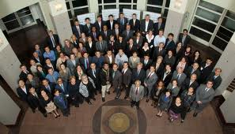
China Goes Global (2006-Present) www.chinagoesglobal.org

Slide 3
Why Study Chinese FDI?
China is among the world’s largest investors
China’s OFDI growth is exponential, but not smooth
Chinese OFDI still a small percentage of GDP
Chinese share of global investment position
OFDI is part of the Chinese policy of going global
Obtaining high technology manufacturing capabilities (Made in China 2025)
China Belt and Road Initiative
Good testing ground for generalizability of FDI and internationalization theories
Do Chinese investors follow the same pattern as their western counterparts?
Do the assumptions of OFDI theories hold for the Chinese?
Notes:
Capital controls are likely to loosen

Slide 4
Mercator’s Chinese OFDI Stock Projections

Slide 5
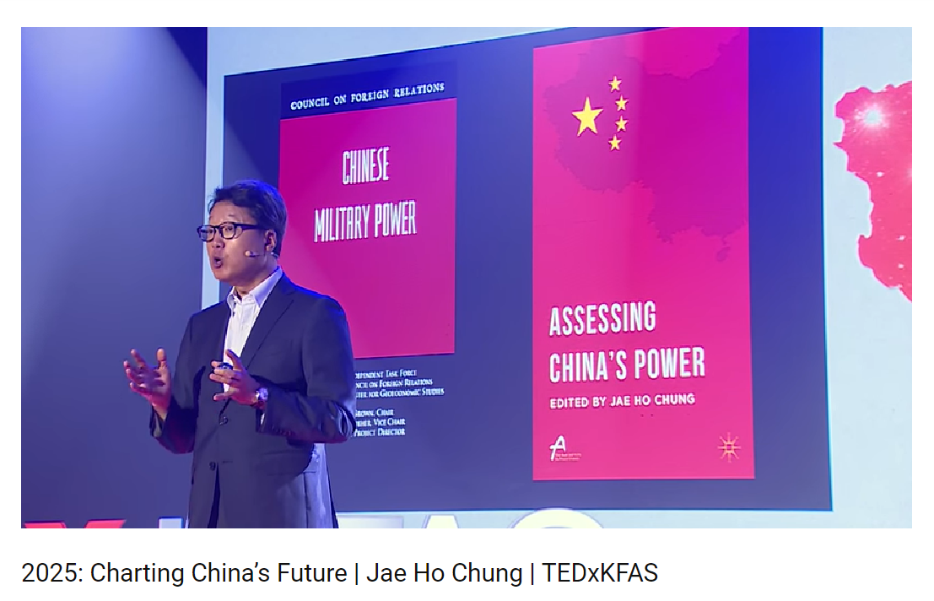

Slide 6
Synthesis of Recent Works
Alon, I., Anderson, J., Munim, Z. H., & Ho, A. (2018). A review of the internationalization of Chinese enterprises. Asia Pacific Journal of Management, 35(3), 573-605.
Alon, I., Anderson, J., Bailey, N. J., & Sutherland, D. (2017). Political Risk and Chinese OFDI: Theoretical and Methodological Implications. In Academy of Management Proceedings (Vol. 2017, No. 1, p. 17640). Briarcliff Manor, NY 10510: Academy of Management.
Lattemann, C., Alon, I., Spigarelli, F., & Marinova, S. T. (2017). Dynamic embeddedness in Chinese firm internationalization. Thunderbird International Business Review, 59(4), 547-559.
Zhang, W., Alon, I., & Lattemann, C. (Eds.). (2018). China's Belt and Road Initiative: Changing the Rules of Globalization. Springer.

Slide 7
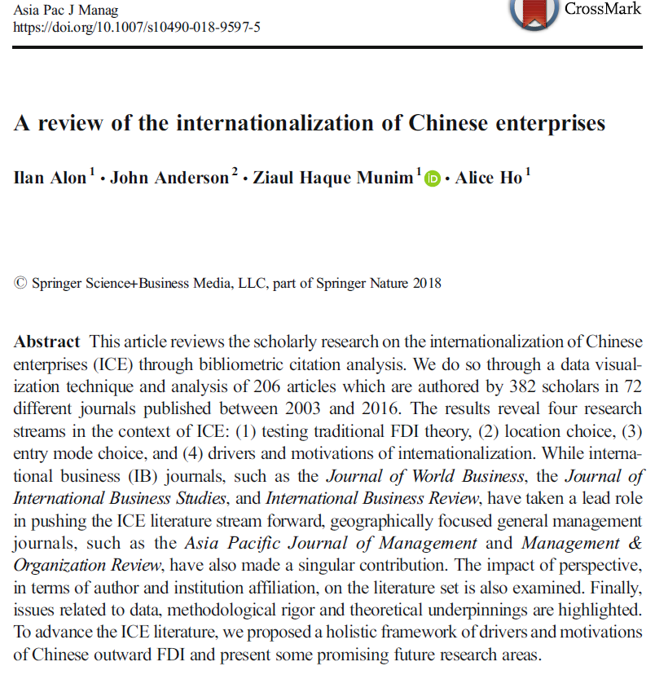

Slide 8
Methodological Underpinning

Slide 9
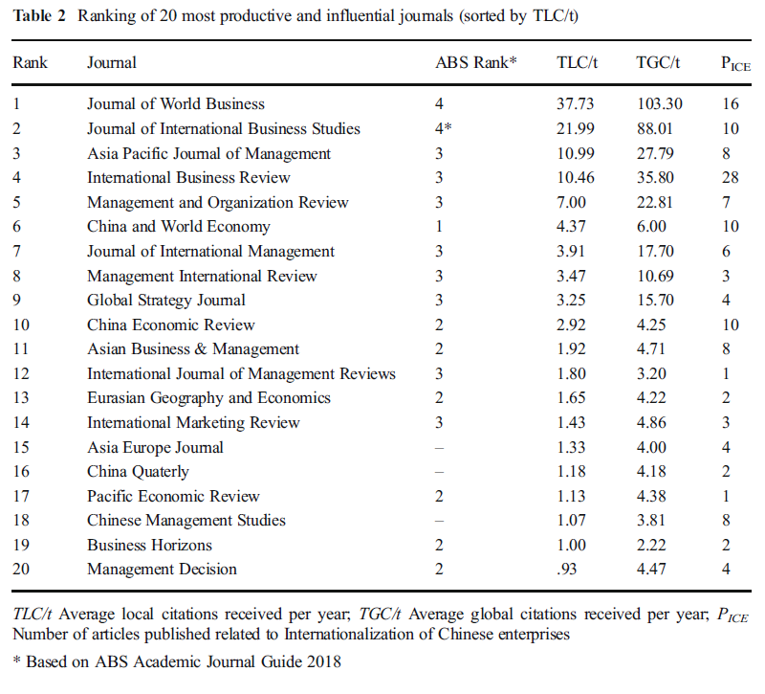

Slide 10
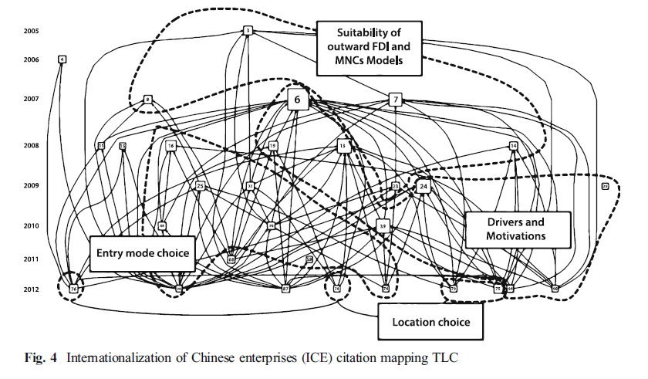

Slide 11
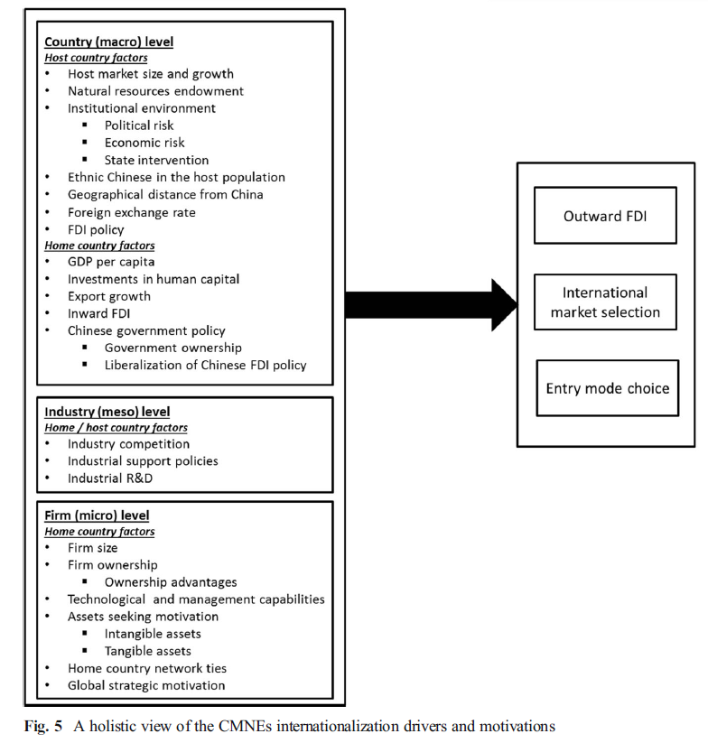

Slide 12
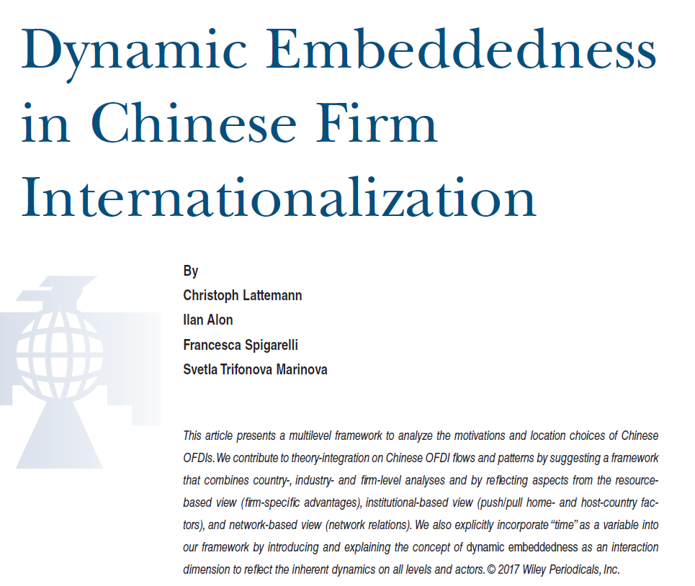

Slide 13
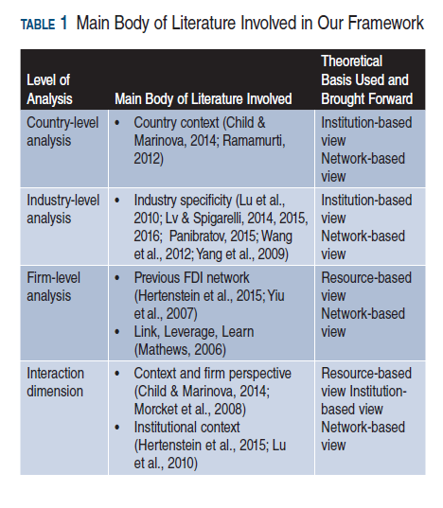

Slide 14
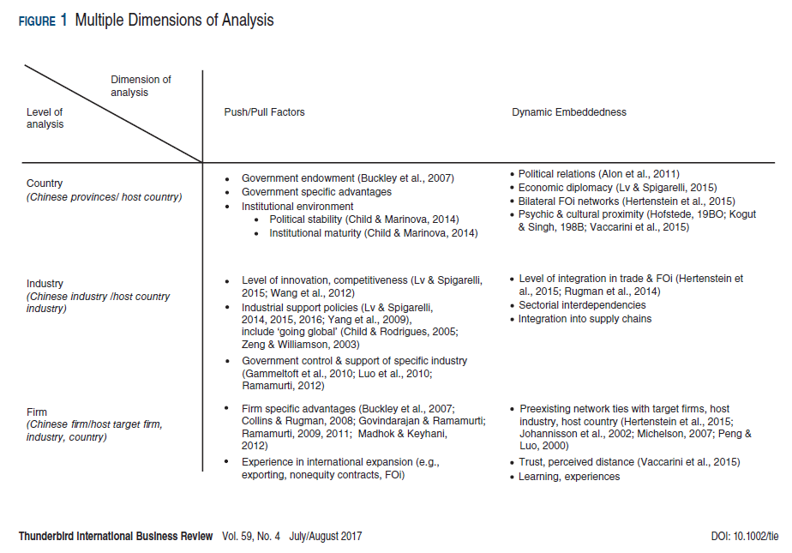
Notes:
Cultural and political determinants

Slide 15
Political Risk and Chinese Outward Investment
Studies maintain that Chinese are attracted or indifferent to political risk
Political risk predicts the opposite
Survey data suggests otherwise
Notes:
Buckley and his colleagues (2007) and other found political risk to encourages FDI from China (inconsistent with theory and survey data)
Non-industrialized perverse attitude to risk (non-profit maximizing behaviors)
Capital market imperfections and institutions specific to China
Political affiliations and connections
bargaining position of the Chinese
Ideological heritage towards developing countries
Country embedded knowledge of political risk management

Slide 16
CMNC Motivations for OFDI
Alon, I., Wang, H., Shen, J., & Zhang, W. (2014). Chinese state-owned enterprises go global. Journal of Business Strategy, 35(6), 3-18.
Notes:
40 Chinese State-Owned Enterprises
Largest SOEs
Survey
Conducted during June – July of 2011
China Center at Rollins College
Shanghai Jiaotong University, Euromed
China Executive Leadership Academy at Pudong (CELAP)

Slide 17
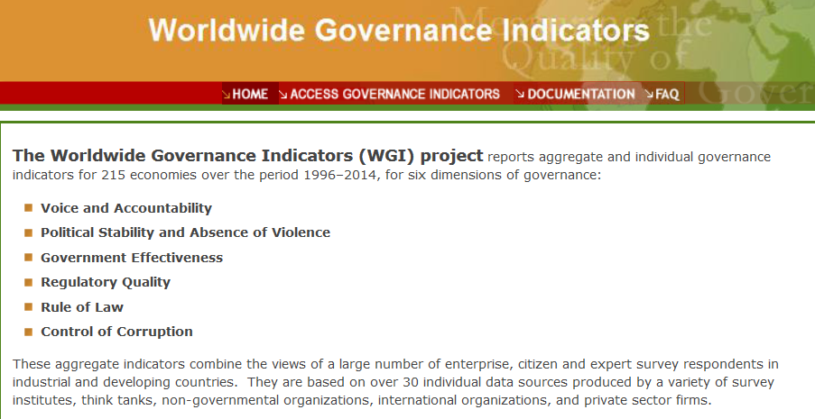

Slide 18
1. Voice and Accountability
Notes:
2007

Slide 19
2. Political Stability

Slide 20
3. Government Effectiveness

Slide 21
4. Regulatory Quality

Slide 22
5. Rule of Law

Slide 23
6. Control of Corruption

Slide 24
Data Problems
Chinese statistics of OFDI (see next page article)
Most past studies use official data (MOFCOM) which does not take the use of tax havens into account.
~80% of all Chinese FDI is routed through tax havens.
Official data states 30% of all FDI into Europe goes to Luxemburg.
Commercial data, which uses ultimate beneficiary ownership has this number at 0.1%.
A more candid picture of private MNE investment than official data. Several drawbacks to commercial data such as many missing or estimated values, only includes M&As of greater than $1 million and greenfield investments of more than $500,000, smaller overall sample size.
Political risk measures
Heritage Foundation measures economic freedom more than political risk – these two are not the same
World Bank aggregates data from (30) secondary sources and then shapes their data.
PRS Group collects and analyzes their own data. The biggest drawback is that these data measure country risk more than political risk.

Slide 25
Notes:
MOFCOM data is flawed
Doesn’t take ultimate investment locations into account
This is a serious drawback: the majority (>50%) of Chinese FDI is routed through tax havens
Commercial data is flawed
Many missing values
Only captures acquisition investments >$1 million; greenfield investments >$500,000

Slide 26
Methods and Results
We construct comparison models using:
1) MOFCOM data and commercial data which take ultimate global ownership into account and
2) different measures for the political risk variable across data sources
Results
Models using MOFCOM data are generally the same as what is found in past literature
Models using commercial data we generally find CMNEs are significantly drawn to locations with low levels of political risk. This relationship is strongest for the World Bank data.
World Bank data results generally conform to traditional theory (i.e. CMNEs are risk adverse)
PRS Group data results generally conform to theory in the case of commercial data, but not in the case of official data
Heritage foundation data reveal a U-shaped relationship between CMNE FDI and risk

Slide 27
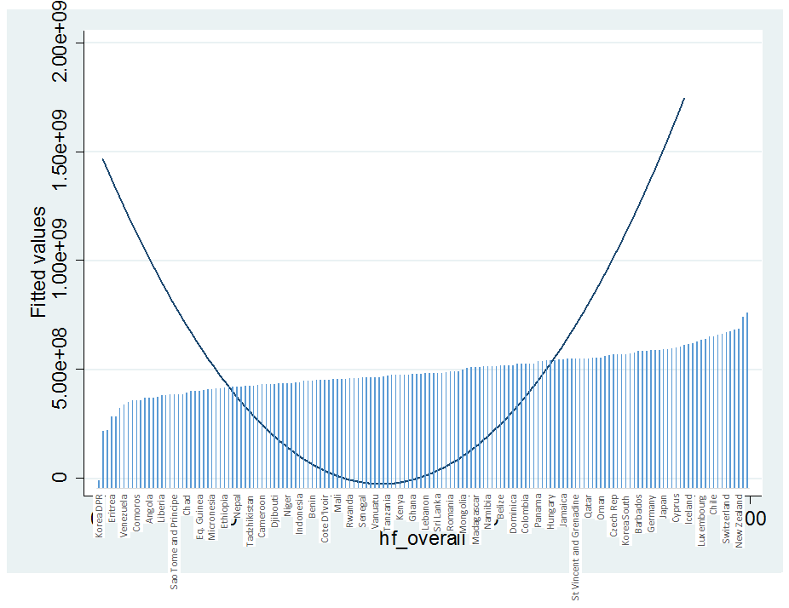
Results
How Chinese FDI is measured is important
Chinese FDI data from MOFCOM are likely to yield non-significant results regardless of political risk variable
This is in line with findings from past studies
Chinese FDI data which take ultimate investment destinations into account (i.e. commercial data) are likely to yield positive and significant results (i.e. Chinese FDI is drawn to locations with low political risk)
How political risk is measured is important
Heritage Foundation data are likely to yield positive significant results regardless of Chinese FDI data source – but this relationship is curvilinear
Political stability and rule of law variables are likely to yield non-significant results regardless of Chinese FDI data source
World Bank political risk data are more likely to yield positive significant results than PRS data when using commercially available FDI data
Corruption and regulatory quality proxies are likely to have a positive relationship with Chinese FDI regardless of data source
This relationship is positive and significant in the case of commercial FDI data
Government accountability proxy is likely to have a negative relationship with Chinese FDI
This relationship is negative and significant in the case of MOFCOM data

Slide 28
Theoretical and Policy Implications
Traditional political risk theory:
The State in China mediates the risk though de-facto political risk insurance to selected locations with specific interest. BRI is an example of such policy.
Chinese FDI and political risk:
Chinese private investment prefers politically stable locations.
Chinese state owned enterprises are risk takers or perceive risk differently in selected markets
Governments with good governance are more likely to attract M&A activity even from China
Chinese multinationals:
Micro political risk model for China is needed
Chinese state enterprises posses special ownership advantages which mitigate some of the political risk
Consider the Belt and Road Initiative
Notes:
There may be classes of CMNEs which are indifferent to political risk (i.e. SOEs with ‘special ownership advantages’), but this relationship is moderated when accounting for the final destination of Chinese FDI (i.e. gaining insight into the final destination of private CMNE FDI).
Measurement matters. It is important to think about what is implied in the political risk data used for empirical analysis.
It is important to take a highly nuanced approach to the measurement of political risk variables
Depending on the variable measurement you are more likely to find positive, negative, or curvilinear relationships
Not all facets of political risk are perceived to be the same to Chinese MNEs

Slide 29
Vexing Research Questions
Is Chinese investment counter cyclical?
Decomposing the firm- and country- specific factors
Boundary conditions for theoretical adaptation
Policy Question
Is China a strategic threat or opportunity?
Ban or Welcome? Regulate? How? Chinese retaliation?

Slide 30
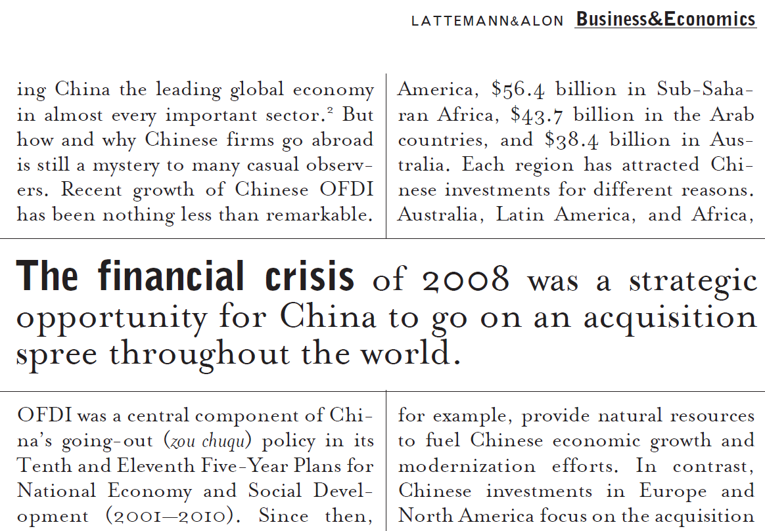

Slide 31
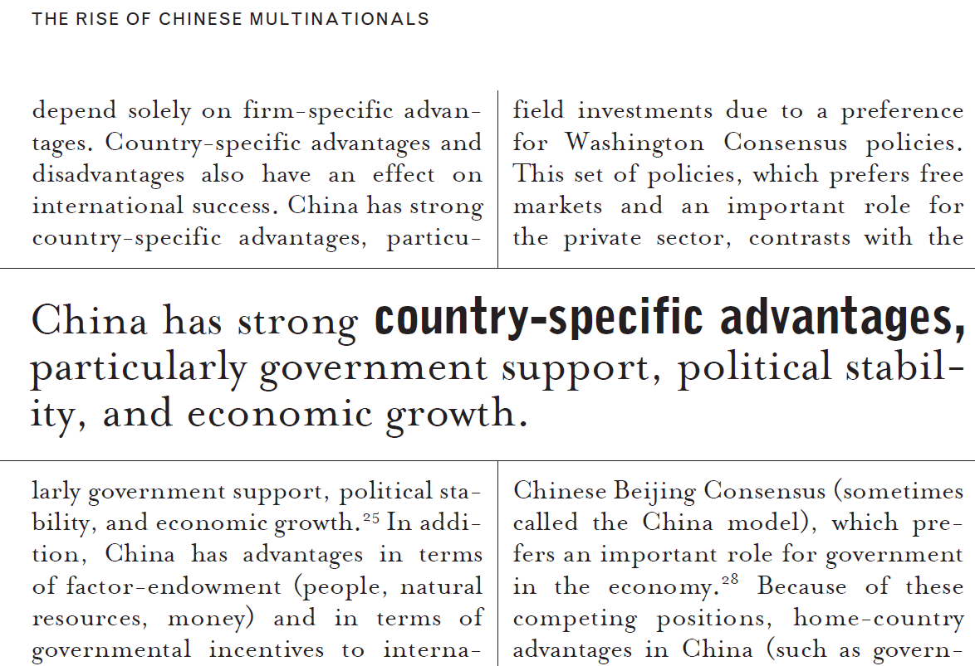

Slide 32
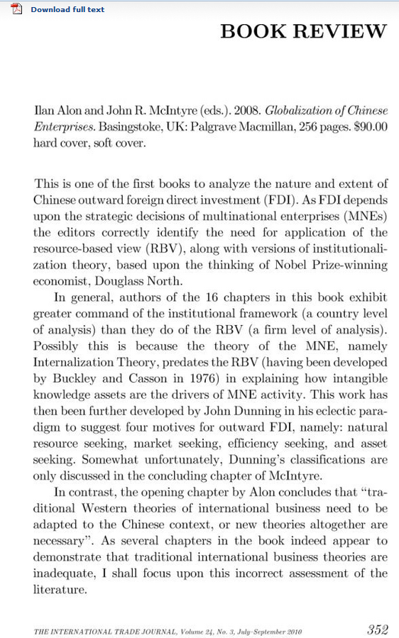
Rugman’s Review
Alon, I., & McIntyre, J. R. (Eds.). (2008). Globalization of Chinese enterprises. Palgrave Macmillan.

Slide 33
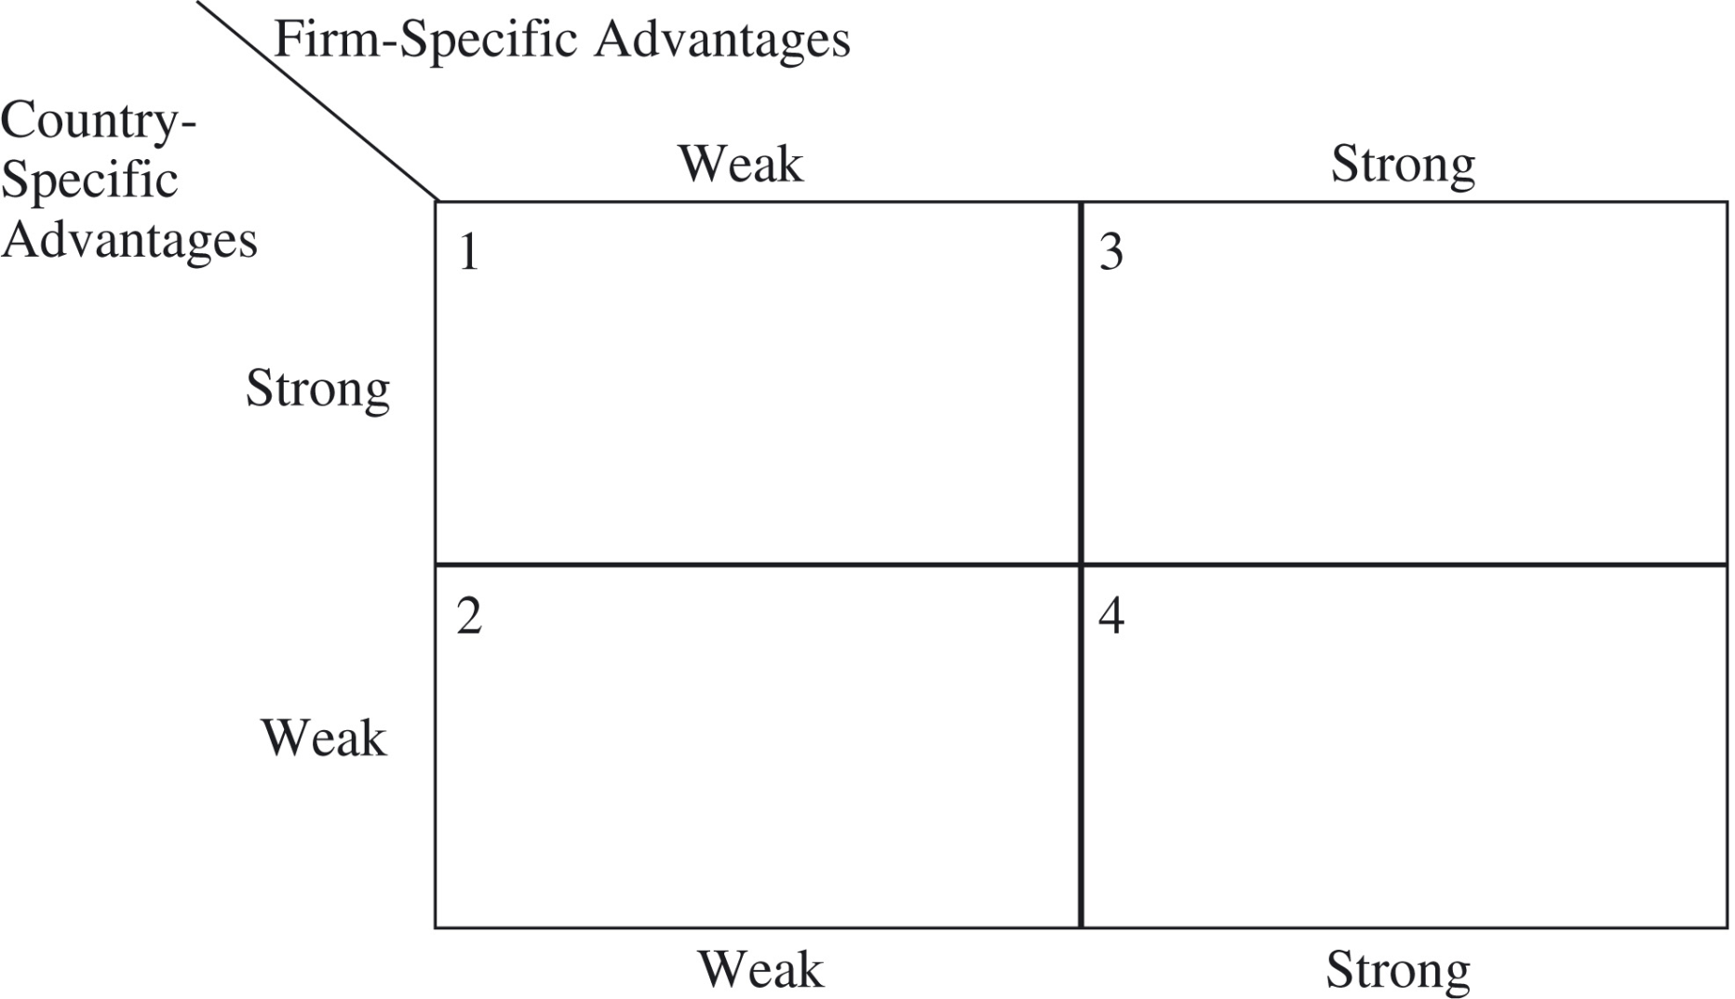
Rugman’s 2x2 Model/Theory

Slide 34
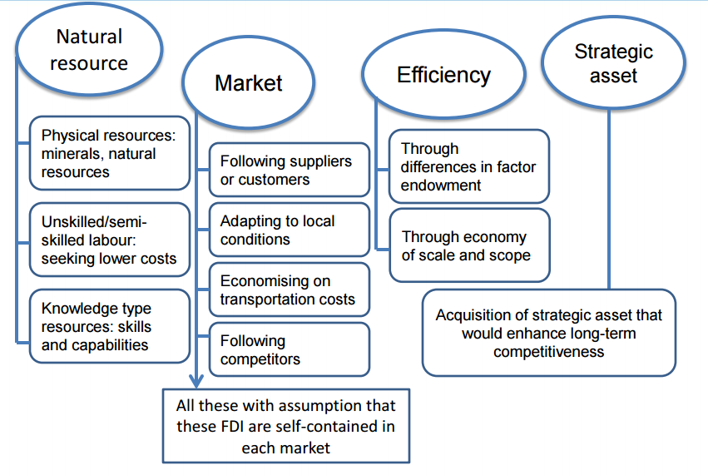
Host Market Investment Motivations Dunning and Lundan
Notes:
Dunning, J. H., & Lundan, S. M. (2008). Multinational enterprises and the global economy. Edward Elgar Publishing.

Slide 35
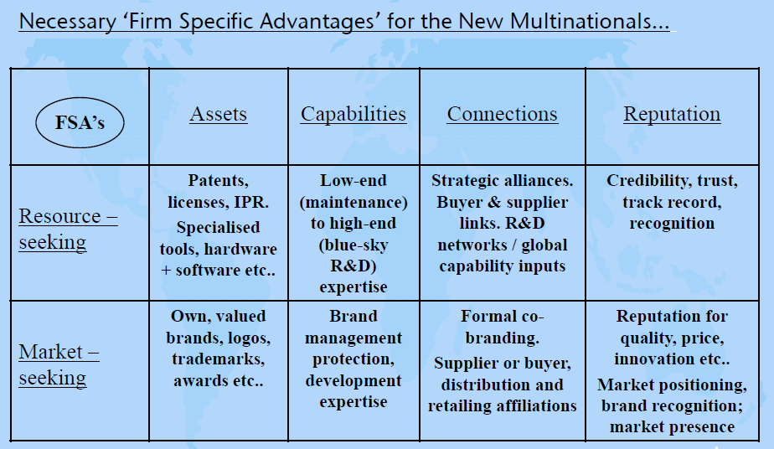
Deconstructing Firm-Specific Advantages Simon Collinson on FSAs

Slide 36
Classifying Firms by Ownership and Organization Yadong Luo: Ownership-Diversification Matrix 中国国际企业/跨国公司的类型：所有权-多样化矩阵
Non-state owned State owned
非国有的 国有的
H International Diversification L
高 国际多样化 低
World-stage
Aspirant
世界舞台进取者
Transnational
Agent
跨国代理
Niche
Entrepreneur
小而精的创业者
Commissioned
Specialist
委托专家
Notes:
36
企业 qǐ​yè 类型 lèi​xíng (form) 所有权 suǒ​yǒu​quán (ownership) 样化 duō​yàng​huà​ diversification 矩阵 jǔ​zhèn​ array / matrix (math.)

Slide 37
A Critique of OLI JF Hennart: Theory of EMM
Hennart, J. F. (2012). Emerging market multinationals and the theory of the multinational enterprise. Global Strategy Journal, 2(3), 168-187.
Notes:
Transaction cost economist
Critical of OLI, the LLL frameworks

Slide 38
Conditions for Theoretical Adaptation
When institutions matter (dometic or foreign or their interactions)
When government influence is relevant
When culture is relevant
When phenomena is indigenous
Alon, Ilan, John Child, and Shaomin Li "Globalization of Chinese firms: Theoretical universalism or particularism." Management and Organization Review 7.2 (2011): 191-200.

Slide 39
Boundary Conditions Vary
Chinese Firms Motivations Show Similarities
Alon, I., Leung, G. C. K., & Simpson, T. J. (2015). Outward Foreign Direct Investment by Chinese National Oil Companies. Journal of East-West Business, 21(4), 292-312.
Alon, I., Yeheskel, O., Lerner, M., & Zhang, W. (2013). Internationalization of Chinese entrepreneurial firms. Thunderbird International Business Review, 55(5), 495-512.
Corporate Governance, Local Institutions, and CSR Show Differences
Are Chinese CEOs Stewards or Agents? Revisiting the Agency–Stewardship Debate HW Hu, I Alon, Emerging Market Firms in the Global Economy, 255-277
Financial marketization and corporate venturing in China: The impact of provincial-level institutions on the pharmaceutical sector, W Dai, I Alon, H Jiao, Journal of Entrepreneurship in Emerging Economies, 2015
Li, S., Fetscherin, M., Alon, I., Lattemann, C., & Yeh, K. (2010). Corporate social responsibility in emerging markets. Management International Review, 50(5), 635-654.
Notes:
Firm competitiveness and resource based theories may apply, augmented by institutional theory

Slide 40
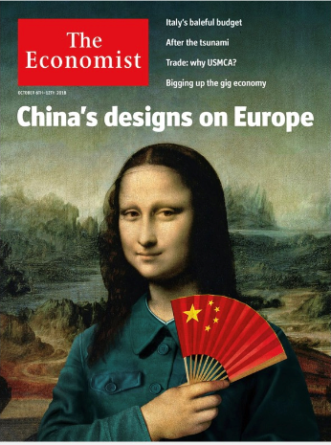
Cost-Benefit of Chinese Investment
The Rise of Chinese Multinationals: A Strategic Threat or an Economic Opportunity
C Lattemann, I Alon, Georgetown Journal of International Affairs 16 (1), 168-175

Slide 41
One Belt, One Road, One Circle, and One Sky
Notes:
New Global Architucture

Slide 42
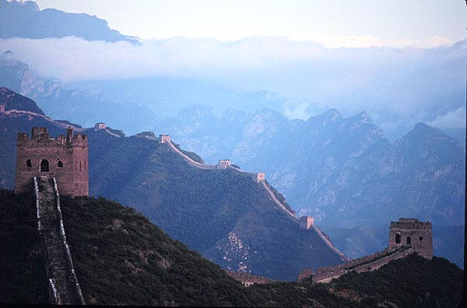
Questions and Answers
Notes:
Talk about latest research: modal choices, greenfield investment

